Slide 1

Template for CISO’s Presentation to Board Audit or Cybersecurity Committee or to the full Board of Directors

Slide 2
Using this Presentation Template
delete this slide after use
This presentation template will help you organize your presentation to the board of directors (or the board audit committee). If you are a new CISO and presenting to your Board for the first time, you should use a variation of this template which can be downloaded here.
Directions
The core presentation is Slides 8-20. Other slides contain instructions and additional materials.
Customize these slides based on the unique context of your organization and industry.
Look out for the box to know which visualizations are modifiable.
Review the guidance in the notes section below each slide.
Use the slides in the appendix section as needed to augment the presentation.
The risk calculations and visualizations shown in this PowerPoint can be automated with Balbix. You can request a demo here or start your free trial.
Editable

Slide 3
You are telling a story…
delete this slide after use
Remember you are communicating about a complex technical topic with people who typically do not have a deep technical background.
Your goal with this presentation is to help the Board meet its fiduciary duties. To do so, you must quantify cyber risk in business terms and map these to your key operational projects and metrics.
Ultimately, what you say will need to inspire the board’s trust and confidence in you and ensure that your function effectively manages information risk. Your best bet is to tell a compelling and simple story. It is more important to be interesting than to be complete!

Slide 4
Decide How You Want Them to Feel
delete this slide after use
Research shows that human beings, including board members, make most decisions emotionally, and then find data to back up what they already decided.
CISOs often tend to lead with lots of detailed technical security data, and as a result, they risk being unconvincing.
You must decide how they want the board to feel as a result of your presentation, and then select the data to back up the emotional arc of the story.
Notes:
Reference for the emotional decision making of humans:
Thinking, Fast and Slow, Daniel Kahneman
https://en.wikipedia.org/wiki/Thinking,_Fast_and_Slow
The main thesis of this book is that of a dichotomy between two modes of thought: "System 1" is fast, instinctive and emotional; "System 2" is slower, more deliberative, and more logical. The book delineates rational and non-rational motivations/triggers associated with each type of thinking process, and how they complement each other, starting with Kahneman's own research on loss aversion. From framing choices to people's tendency to replace a difficult question with one which is easy to answer, the book summarizes several decades of research to suggest that people have too much confidence in human judgement.
Daniel Kahneman was awarded the 2002 Nobel Prize in Economics for his research.

Slide 5
Don’t forget the data
delete this slide after use
While it is important to lead with emotion and tell a story, it is very important to follow with data!
Many CISOs cannot quantify and equate cyber risk in dollars and cents (or euros, pounds, rupees, yen, etc.) of expected loss.
Remember the common currency that everyone understands is money. If you speak in relative terms, like high, medium or low risk your board member has no real idea if your definition of “medium” is ”an acceptable level of risk”. When you quantify in money terms, e.g., ransomware is a $50M risk item, this becomes easy.
Notes:
Reference:
Storytelling with Data: A Data Visualization Guide for Business Professionals 1st Edition
by Cole Nussbaumer Knaflic
https://www.storytellingwithdata.com/books
https://www.amazon.com/gp/product/1119002257

Slide 6
Outline of your presentation
delete this slide after use
Summary of last meeting
Current state of cyber risk
Disclose key cyber risk metrics
Discuss special topics for 2024
Summarize the previous Board update.
Follow-up on on any incomplete conversations or action items.
Use this section as an opportunity to highlight current risks and threats to your organization & quantify these loss scenarios in money units. Propose a mitigation plan
Present metrics that demonstrate progress towards the annual or quarterly objectives that you presented earlier to the Board.
There are 2 special topics for this board meeting.
SEC disclosures
Impact of GenAI

Slide 7
Cyber Risk
for <Company X>
Board Presentation
Month, 2024
Add Your Logo Here
Notes:
Modify this slide to add your organization’s name and logo.
The date field is auto-updating. If you are preparing your slides for a specific date, you may want to change that.

Slide 8
Last Update to Board
Risk Landscape Update
AGENDA
Cyber Risk Metrics
Special topics

Slide 9
Summary of our last discussion
1.
2.
What is risk exposure from our third-party vendors?
What is our readiness for ransomware scenarios?
3.
4.
Question: what is our threat landscape in 2024? Impact of GenAI on cyber?
Question: what are we doing about SEC regulations?
Notes:
Change this slide to summarize the last few topics that were covered in the previous board meeting. This is your opportunity to update the board on any open items or follow up from that discussion.
In this particular example, we discussed ransomware and third-party risk in the last board meeting. The board requested to be informed about new threats (including GenAI related) and SEC disclosure readiness in the last board meeting.

Slide 10
Last Update to Board
Risk Landscape Update
AGENDA
Cyber Risk Metrics
Special topics

Slide 11
Cyber risk continues to grow
In the last 24 months, there has been a sharp increase in the number and cost of data breaches.
Mean time of arrival of new exploitable vulnerabilities
Cyber risk
60 days
$100M
$50M
14 days
2022
2023
2024
2022
2023
2024
GenAI based attacks are already in use by adversaries
Editable
Notes:
This slide is useful when you want to highlight a shift or change in industry conditions and explain to the board why the cybersecurity measures that were “good enough” in the past are no longer cutting it.
You can substitute your company’s values for risk in the figure on the right.
This is also where you can introduce that attackers are beginning to use GenAI as a tool to make attacks significantly more effective.

Slide 12
Lessons from Okta, MGM, Caesar, T-Mobile and others
NIST framework
Other organizations
Our organization
IDENTIFY | The impacted organizations had gaps in their asset visibility and vulnerability assessment program. | We have gaps in our visibility and VM program, but we have made good progress. A key area of investment is an AI-powered risk-based approach to vulnerability and control management.
PROTECT | Social engineering and compromised credentials continue to be key points of the initial attack vector. Unpatched vulnerabilities continue to be the 2nd key attack vector. | We are improving password policies, MFA and user training. And mandating riskiest vulnerabilities are patched within 7 days. Investment in AI will let us do this without increasing costs.
DETECT | The impacted organizations were hampered by their lack of visibility into IT & user activity. | We have invested heavily in our monitoring capabilities. We are reviewing our detection and adding 24x7 SOC monitoring.
RESPOND | Many didn’t have a strong response plan, and they had to shut down their operations as precautionary measure. | Our response plan includes oversight from the board as well as appropriate support from law enforcement
RECOVER | Most organizations were able to recover but not without significant disruption and reputational impact | We have documented our recovery plan including key stakeholders responsible for recovery
GOVERN | Most organizations did not have oversight from their senior executives and the board for cybersecurity policies and procedures | We are setting up executive committees for cybersecurity governance are looking at looking to add cybersecurity expertise to the board for appropriate oversight

Slide 13
Lots of noise in the world of cyber vulnerabilities
With fewer than 1% of vulnerabilities exploited, it is important to take a risk-based and environment specific approach to mitigating vulnerabilities
26K
<1%
50%
Vulnerabilities disclosed in 2023
Vulnerabilities were exploitable
Critical vulnerabilities were in OS or infrastructure
GenAI presents a unique opportunity to manage vulnerabilities effectively based on risk
Supply Chain
Notes:
Here you can introduce why managing cyber risk based on risk is imperative.
This is an excellent way to introduce the need for continuous, automated cybersecurity risk visibility, risk quantification and risk-based prioritization of all security initiatives and vulnerability management.

Slide 14
Last Update to Board
Risk Landscape Update
AGENDA
Cyber Risk Metrics
Special topic

Slide 15
Key cyber metrics
use this slide or the next one
cyber risk
cyber resilience
Digital risk visibility (% assets and apps) | Controls effectiveness | User risk visibility (% users) | Compliance risks related to cybersecurity
Mean time to mitigate vulnerabilities and misconfigs (days) | Protective policy management effectiveness | Phishing training click-throughs | 3rd party risk visibility
# systems with high-risk vulnerabilities and misconfigs | Incident containment and remediation times (hours) | Multifactor authentication coverage | Zero-trust deployment coverage
# of EOL systems | Ransomware workaround readiness | Privileged access management | Cyber risk awareness and management training
Editable
Notes:
Pick your specific metrics and your color coding.
Two suggested color coding we have seen to be useful:
1. Green/Gray for what you have vs what you are working on to indicate your blind spots
2. Blue/Orange for cyber risk vs cyber resilience to indicate the maturity of your cyber risk program

Slide 16
Key cyber metrics
use this slide or the previous one
operational
don’t have
Digital risk visibility (% assets and apps) | Controls effectiveness | User risk visibility (% users) | Compliance risks related to cybersecurity
Mean time to mitigate vulnerabilities and misconfigs (days) | Protective policy management effectiveness | Phishing training click-throughs | 3rd party risk visibility
# systems with high-risk vulnerabilities and misconfigs | Incident containment and remediation times (hours) | Multifactor authentication coverage | Zero-trust deployment coverage
# of EOL systems | Ransomware workaround readiness | Privileged access management | Cyber risk awareness and management training
Editable
Notes:
Pick your specific metrics and your color coding.
Two suggested color coding we have seen to be useful:
1. Green/Gray for what you have vs what you are working on to indicate your blind spots
2. Blue/Orange for cyber risk vs cyber resilience to indicate the maturity of your cyber risk program

Slide 17
Our cyber risk
$_M
_%
$_M
$M
Risk
Likelihood
Impact
There is ___% chance that we will have an impact of $___ M from a cybersecurity event this year.
Editable
Notes:
You should substitute your values for Breach Risk, Likelihood and Impact as appropriate. The trend chart can be updated by right-clicking and selecting “Edit Data in Excel”.
It is critical that you use a consistent, data-driven and therefore defensible approach for constructing and populating your risk dashboard.
These widgets can be also automatically generated by Balbix.
Remember to lead with emotion when presenting these numbers. Most members of the board will take the cue from how you present this data interpret these numbers as good, neutral or bad. $37M of cyber risk may be completely acceptable or not depending on the size and risk appetite of your business.
You must resist the urge to sugarcoat things and paint an overly optimistic (“all green”) picture of cybersecurity posture. Experienced board members will see right through this.

Slide 18
Last Update to Board
Risk Landscape Update
Agenda
Cyber Risk Metrics
Special topic

Slide 19
Special topic: The SEC cybersecurity rule
Our annual 10-K on cybersecurity rule provides basic context on risk management
Our goal is to build a system for materiality determination based on our own data
The system will provide a framework for managing the infosec program and providing disclosures to cyber governance team
Notes:
A couple of references on this topic are at:
https://www.balbix.com/blog/honest10k/
https://www.balbix.com/blog/sec_jul2023/

Slide 20
Special topic: GenAI
Gen-AI is enabling attackers to create very effective attacks
GenAI is our greatest opportunity to improve the effectiveness of our infosec program and address new GenAI threats
The use of public GenAI based systems like ChatGPT poses a significant threat to company IP
Notes:
Position GenAI is a clear and present danger, as well as the only the only way to deal with the new threats.
From a cyber defense and insider threat perspective, GenAI presents a mechanism for organizations to observe, analyze and track all the data that no organization otherwise has the time or capabilities to track and analyze. Managing cyber risk is now a huge data problem, and ultimately your GenAI capabilities in cyber will be fighting the attackers’ GenAI capabilities.

Slide 21
Appendix

Slide 22
INFOSEC MANAGES BUSINESS-LEVEL RISK
Cyber Breach Risk
Compliance Risk
Strategic Risk
Operational Risk
Financial Risk
Reputational Risk
A theft of IP leads to bad press and long term value loss
A ransomware attack leads to downtime and loss of revenue
A compliance violation leads to a big fine and bad press
Loss of customer data results in bad press and harms customer trust.
Notes:
Customize this slide with ‘bad outcomes’ that are specific to your organization.
Use this slide to make the connection between information and compliance risk and Board-level business risks. It is very important that the Board understands that your presentations are centered around managing business risks that can harm the organization’s strategic objectives rather than around low-level technical details that do not merit Board-level concern.

Slide 23
THE BOARD’S ROLE IN CYBER RISK OVERSIGHT
5 Principles of Effective Cyber Risk Oversight: Guidance by National Assoc. of Corporate Directors
1
Boards should approach cybersecurity as an enterprise-wide risk management issue, not just an IT issue
2
Boards should understand the legal implications of cyber risk as they apply to the company’s specific circumstances
3
Boards should have adequate access to cybersecurity expertise, and discussions about cyber-risk management should be given regular and adequate time on the board meeting agenda
4
Boards should set the expectation that management will establish an enterprise-wide cyber-risk management framework
5
Board-management discussion about cyber risk should include identification of which risks to avoid, accept, and mitigate or transfer through insurance, as well as specific plans
Source: National Association of Corporate Directors, Cyber-Risk Oversight Handbook, 2020
Notes:
Note: This slide uses the National Association of Directors’ guidance because it is broadly applicable across industry. Chat with your CEO to understand if your Board follows a different set of guidelines, and then change this slide appropriately.
Information Sources:
National Association of Corporate Directors: https://www.nacdonline.org/cyber
U.S. Securities and Exchange Commission: https://www.sec.gov/spotlight/cybersecurity.shtml

Slide 24
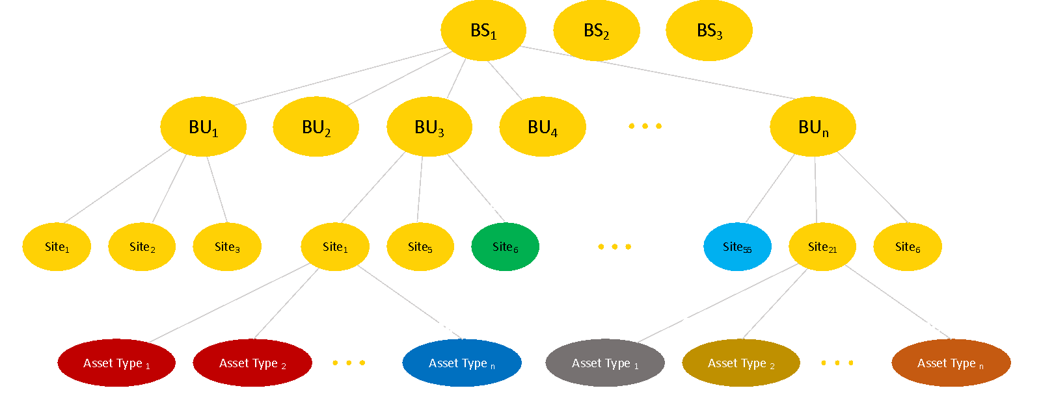
THREE LAYERS OF INFORMATION RISK MANAGEMENT
Layer 3. Internal Audit
Internal Audit provides the final assurance that information risks are being managed within the organization’s risk appetite.
Internal Audit
Layer 2. Risk Management
Legal
HR
Responsibilities:
Mapping assets to risk owners
Identifying and quantifying known and emerging risks
Setting up and facilitating risk management workflows
Information Security
Compliance
Privacy
Business Segment
Business Unit
Layer 1. Risk Owners – in IT or in the Business Units
Responsibilities:
Owning and managing risks, e.g., patching software
Maintaining effective security controls
Making daily risk management decisions
Site
Notes:
The goal of this slide is to make is that the Board understands the Infosec team leads a broad cross-functional risk management effort. Cybersecurity is not simply “the Security team’s problem.”
If you do not have a formal Internal Audit function at your organization, you should merge Layers 2 and 3 and change the title of this slide.

Slide 25
OUR INFOSEC FUNCTION IN DETAIL
CISO and Deputy CISO
Manage Information Security Risk
Manage Compliance and 3rd Party Risks
Interact with CEO and Board
Manage Incident Response
Manage Security Architecture
Respond to Regulatory Requirements
Manage Data Classification
Risk Management Strategy
Monitor Systems and Events
Manage Vulnerabilities and other risk items
Maintain Records Management and E-Discovery
Manage Business Continuity and Disaster Recovery Plans
Drive Ownership And Accountability
Operate Security Controls
Evaluate and oversee deployment of new security tools
Manage Data Privacy
Manage Employee Awareness & Training
Manage Information Security Budget
Manage Third-Party Risks
Manage Information Security Vendors
Hiring and Training
Measure Metrics and Performance
Notes:
Customize this slide to represent the full set of activities and sub-activities performed by your Infosec team, and the corresponding responsibilities.

Slide 26
OUR RISK REDUCTION JOURNEY
Phase 1: Visibility
  Gaining visibility into our assets, applications vulnerabilities and controls. With visibility we can identify material assets and identify coverage gaps.
Visibility
V = 75%
From this point onwards you have sufficient cyber risk visibility to start burning down risk
Phase 2: Burndown
  Discuss acceptable risk levels. Break up the enterprise into groups of assets and assign risk owners to quickly burn down risk to acceptable levels.
Time
Phase 1
Gain Visibility
Cyber Risk
  Phase 3: Manage
  Evaluate and prioritize risk issues and dispatch them to risk owners for remediation. Define policies to ensure risk can be managed at acceptable levels.
Acceptable Risk
Time
Phase 1
Gain Visibility
Phase 2
Risk Burndown
Phase 3
Continuous Risk Management and Optimization

Slide 27
CYBER RISK MANAGEMENT PROJECTS
Capability
Initiatives
2024
2025
Identify
Implement continuous cybersecurity posture visibility. Build risk owner’s matrix and update quarterly.
Asset Criticality Analysis
Deploy Balbix
Build risk group hierarchy and assign risk owners
Implement strong identity with adaptive authentication. Improve patching posture. Deploy zero-trust.
Build Balbix workflows for non-patching risk items
Turn on Okta adaptive auth
Protect
Deploy Okta
Improve Patching Posture using Balbix
Deploy Zero-trust
Detect
Incorporate threat feeds in SOC workflows.
Integrate Recorded Future in SOC
Respond
Improve incidence response with automated playbooks
Integrate TBD XDR platform in SOC
Recover
Review & update business continuity plan every quarter
Review & identify gaps in plan with risk owners
Develop plan update to address gaps
Implement & test plan
Notes:
Use this slide to provide an overview of your Infosec projects, and how they will serve to improve your cybersecurity posture.
Your main objective is to provide assurance that you are effectively managing to your strategic roadmap and to answer questions about the goals. Be prepared to discuss any project you list on this slide.

Slide 28
If you found these slides useful…
delete this slide after use
Balbix can help you with overall cyber risk Governance and overseeing the many critical pieces of your Infosec program.
The Balbix platform uses AI to help discover and analyze your assets and attack surface to Identify areas of greatest risk. This is foundational to effective capabilities for Protect , Detect , Respond and Recover .
Balbix continuously quantifies your cyber risk in $s, and prioritizes your vulnerabilities based on risk.
Balbix also enables you automate critical elements of your cybersecurity program and quantify changes in risk as you improve your cybersecurity posture. The next few slides has some additional examples of this.
Start your free Balbix trial >>>

Slide 29
IDENTIFY
delete this slide after use
Maturity Level
Incomplete or manual inventory
Incomplete and non-continuous vulnerability assessment
Continuous asset discovery and inventory
Continuous vulnerability assessment across 100+ attack vectors incl. people
Can quantify the impact of deployed mitigations on risk
Previous level capabilities
New vulnerabilities and risk items are automatically mapped to risk owners
Risk owners are notified about risk items that require action
Previous level capabilities
Risk is understood in units of currency
Different mitigation scenarios are simulated and compared
Partial
Informed
Repeatable
Adaptive
Balbix can help your organization implement all capabilities that are needed for Adaptive Level Maturity for Identify.
Start your free Balbix trial >>>
Notes:
Identify is the foundational layer in the NIST cybersecurity framework. You cannot protect what you don’t know about!
The 1st Identify capability that your cybersecurity program needs is: automatic and comprehensive discovery of enterprise assets (devices, applications, services and users) across on-prem, cloud and 3rd parties.
The 2nd piece is continuous assessment for vulnerabilities and risk items for all enterprise assets (including people) across 100+ attack vectors.
The 3rd capability you need is mapping risks and vulnerabilities at the device-network level to business units and risk owners, and quantifying risk in money terms.
Because of the size and complexity of the attack surface, “Identify” is not a human scale problem anymore. https://www.balbix.com/product-overview/why-balbix/
We built Balbix specifically to harness the power of advanced AI and provide these capabilities for you. You can request a demo (https://www.balbix.com/request-a-demo/) or start your free trial. (https://www.balbix.com/free-signup/).

Slide 30
PROTECT
delete this slide after use
Maturity Level
“Partial” maturity level for Identify capabilities
Some basic protections in place such as anti-virus and Internet firewall
“Informed” or higher maturity level for Identify capabilities
EDR and VPN deployed, security awareness training
Continuous vulnerability management for the majority of organization’s assets
Previous level capabilities
Strong Identity
Continuous security & risk training of people
Partially segmented network
Previous level capabilities
Proactive management of vulnerabilities and risk items
Zones and Adaptive Trust
Periodic penetration testing of defenses
Partial
Informed
Repeatable
Adaptive
Balbix can help your organization implement important Identify and Protect capabilities (underlined above) that are needed for increased maturity of Protect
Start your free Balbix trial >>>
Notes:
Your 1st line of Protect capabilities is:
EDR, firewall and VPN
Continuous vulnerability management
Balbix implements continuous risk-based vulnerability management OR can integrate with your existing vulnerability tool.
As you make progress in improved Protect capabilities, Balbix will automatically detect your new mitigations and compensating controls (such as EDR) and update your risk calculation to take into account these new capabilities.
Balbix can also generate continuous dashboards and reports that tell each risk owner what open vulnerabilities, risk items and tasks that they need to worry about. Risk owners can be compared against each other and incentivized to be at the top of the cybersecurity leaderboard. This can go a long way in developing a culture of shared risk ownership and driving down risk.

Slide 31
DETECT
delete this slide after use
Maturity Level
“Partial” maturity level for Identify capabilities
Security Operations Center (SOC) not implemented
“Informed” or higher maturity level for Identify capabilities
Basic SOC with partial monitoring coverage of security events from organization’s assets
Previous level capabilities
Advanced SOC with comprehensive monitoring and detect coverage of security events
Previous level capabilities
Proactive threat hunting capabilities
Prioritization of SOC activities based on Risk
Partial
Informed
Repeatable
Adaptive
Balbix can help your organization implement important Identify and Detect capabilities (underlined above) that are needed for increased maturity of Detect
Start your free Balbix trial >>>
Notes:
Balbix contains risk context for all your assets including software version configuration, open vulnerabilities, threats, exposure, compensating controls and asset criticality information.
This information can be accessed by your SOC team and used to prioritize their analysis tasks.

Slide 32
RESPOND
delete this slide after use
Maturity Level
“Partial” maturity level for Identify capabilities
No formal Respond Plan
“Informed” or higher maturity level for Identify capabilities
Manual Respond Plan for critical organization assets
Previous level capabilities
Automated Respond Plan for all enterprise assets
Periodic review and update of Respond Plan
Previous level capabilities
Optimized Respond Plan for all enterprise assets
Partial
Informed
Repeatable
Adaptive
Balbix’s Identify capabilities (underlined above) are foundational to implement increased maturity of your Respond Plan
Start your free Balbix trial >>>
Notes:
Balbix’s Identify capabilities are foundational to implement increased maturity of your Respond Plan.

Slide 33
RECOVER
delete this slide after use
Maturity Level
“Partial” maturity level for Identify capabilities
No formal Recover Plan
“Informed” or higher maturity level for Identify capabilities
Manual Recover Plan for critical organization assets
Previous level capabilities
Automated Recover Plan for identified critical assets
Periodic review and update of Recover Plan
Previous level capabilities
Recover Plan optimized for timely restoration of assets and functions based on business criticality
Partial
Informed
Repeatable
Adaptive
Balbix’s Identify capabilities (underlined above) are foundational to implement increased maturity of your Recover Plan
Start your free Balbix trial >>>
Notes:
Balbix’s Identify capabilities are foundational to implement increased maturity of your Recover Plan.

Slide 34
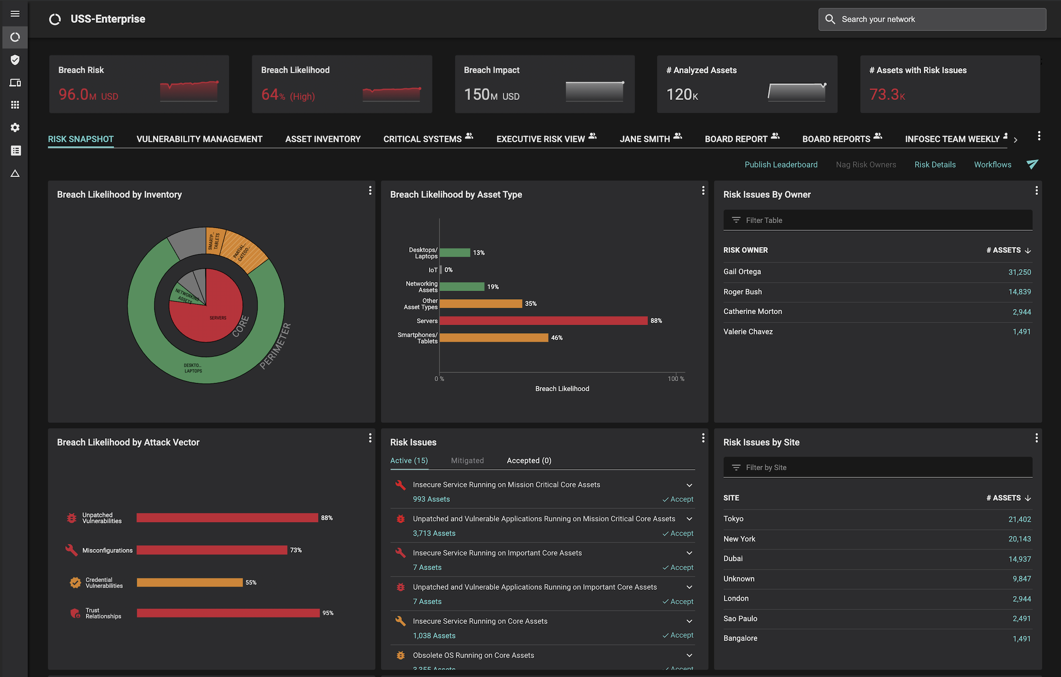
LEARN MORE ABOUT BALBIX
In 30 minutes, we will show how Balbix can help you understand and manage your cyber risk with GenAI
With Balbix, you will use AI, automation, and gamification to discover, prioritize, and mitigate your unseen vulnerabilities.
You will also be able to quantify your cyber risk in monetary terms, which are traceable to operational metrics and asset attributes driving this risk. You will be presented with practical actions you can take to mitigate this risk.
Request a Demo
A single, comprehensive view of your cyber risk
https://www.balbix.com/request-a-demo/

Slide 35
Good Luck!
delete this slide after use
Start your free Balbix trial >>>

