Slide 1
Template for CISO’s Presentation on SEC Cybersecurity Rule
To CEOs & Board of Directors

Slide 2
General Directions
This presentation template includes key slides on the SEC Cybersecurity Rule that you can present to your CEO or the board of directors
Directions
The core presentation is Slides 4-7. Other slides contain instructions and additional materials
Customize these slides based on the unique context of your organization and industry
Use the slides in the appendix section as needed to augment the presentation

Slide 3
SEC Cybersecurity Rule Update
October 2023
Notes:
Modify this slide to add your organization’s name and logo.
The date field is auto-updating. If you are preparing your slides for a specific date, you may want to change that.

Slide 4
Summary of the SEC Rule
1
What are the new requirements?
2
How does the SEC describe materiality?
3
What should go into our new 8-K and 10-K forms?

Slide 5



Requirements in a nutshell
Cyber Incident Reporting
Cyber Risk Management & Strategy
Cyber Governance
Form 8-K Item 1.05, Form 6K
Regulation S-K Item 106 (b)
Regulation S-K Item 106 (b), Form 20F
Companies must report material cybersecurity incidents in Form 8-K within four business days of materiality determination.
Exceptions for public safety and national security situations.
Materiality determination should be based on federal securities law materiality, including quantitative and qualitative factors.
If required information is not determined or is unavailable at the time of the filing, the 8-K should include disclosure of this fact, and the 8-K should be later amended when the information is determined or becomes available.
Company must describe process for assessing, identifying and managing material risks from cyber threats.
And describe whether any risks from cybersecurity threats have materially affected (or are likely to materially affect) business strategy, results of operations, or financial condition
Company must describe governance of cyber security risks as it relates to:
The board’s oversight of cybersecurity risk, including identification of any board committees responsible for oversight and the process by which they are informed about cyber risks
Management's role and expertise in assessing the managing material cyber security risk and implementing cyber security policies, procedures and strategies.

Slide 6
The most important concept—materiality
How does SEC define it
Who should be involved
Addressing grey areas
Any reasonable person deemed it material for investment decisions
Materiality factors go beyond immediate effects, including long-term ones
Consider a range of qualitative factors, not just number of records impacted
Multiple stakeholders across leadership, security, finance, risk, legal.
Build a playbook for identifying material incidents, disclose criteria.
Security will play a role, but needs collaboration
Any doubts about materiality should favor the investor.
When in doubt, disclose.
The four-day reporting window for material cyber incidents begins upon materiality determination, not incident detection.

Slide 7
What goes into our new 8-K and 10-K forms
Form 8-K
When did the incident occur and who was notified once it was determined material? Who was involved and what information/records did we lose during this incident? How will this incident impact our forward-looking revenue and expenses? How does it impact our shareholders— do we have insurance to cover?
Form 10-K
What's our process for assessing/mitigating cybersecurity risks? What tools and methodologies are used for continuous cyber risk assessment? Who is responsible for cybersecurity governance program? How do we ensure that cybersecurity is an integral part of our business operations?

Slide 8
Appendix Slides
Notes:
Modify this slide to add your organization’s name and logo.
The date field is auto-updating. If you are preparing your slides for a specific date, you may want to change that.

Slide 9
Industry Gap Analysis
Where most companies are today
Cybersecurity Mature Companies
Poor awareness of cyber risks
Unclear how 8-K and 10-K disclosure processes will work in practice
Struggling to raise awareness of cyber risks
Cybersecurity discussions with senior leaders and board are perfunctory, lacking substance and rigor
Rebuilding board and management structures for overseeing management of material risks
Struggling with gap between board perceived material cyber risk and actual operational cybersecurity posture
Cyber Governance
Do not have a data-driven method to determine materiality
SOC and IR materiality guidelines are
ad-hoc
Takes too long to research and triage
Rely on tabletop exercises to validate readiness to disclose material incidents within 4 business days
Unsure if current ad-hoc materiality determination procedures will stand up new 8-K filings
Building and optimizing security data lakes to provide improve context available for SOC for better materiality determination happens
Building and optimizing procedures for 8-K filings within 4 business days, but concerned about qualitative vs quantitative materiality determination
Cyber Incident Reporting
Do not have accurate inventory of assets/apps with business context
Worry about gaps in tooling and visibility
Don’t know about all material assets
Risk assessments are infrequent not data-driven
Lack of confidence in subjective knowledge about material cyber risks
Unclear what actions will decrease risk
Risk management decisions driven by subjective opinions
Aligning against NIST CSF, but struggling to assess and report on maturity progress
Discomfort about what to put in 10-K
Using FAIR to quantify cyber risk, but struggling with subjective input & lack of traceability and actionability
Trying to drive shared ownership and accountability across cyber risk owners in the organization
Improving cyber risk calculations to be data driven and account for business context and effectiveness of controls
Beginning to use automation and AI to implement continuous controls and maturity progress assessments. Process is expensive
Cyber risk management and strategy

Slide 10
Our journey begins with asset visibility
Materiality for SEC reporting
Start
Accurate
Asset Visibility
Data-driven Cyber Risk Model
Executive/BOD reporting
Cyber risk insurance/reporting
Inventory of assets, apps and users with cybersecurity, IT and business context combined from all our tools
Includes vulnerabilities, threats, exposure, security controls and business impact

Slide 11
If you found these slides helpful
Balbix can help you determine materiality and comply with SEC cybersecurity rule.
Balbix will help you provide visibility into your all your assets and automate critical elements of your cybersecurity program and quantify changes in risk as you improve your cybersecurity posture. The next few slides has some additional examples.

Slide 12
How Balbix can help
Materiality determination
Cyber risk management
Governance and compliance
  Balbix can help you determine whether an incident, application, asset, threat or vulnerability is material, by analyzing all data from IT, security, and business tools and identifying if they pose material risk to the organization
  Balbix can help you to quantify and manage material cyber risks down to acceptable levels with a data-driven model that be traced to specific assets
  Balbix enables you to unify cyber governance, operational cybersecurity, and compliance to enable better management of material cyber risks in a single platform

Slide 13
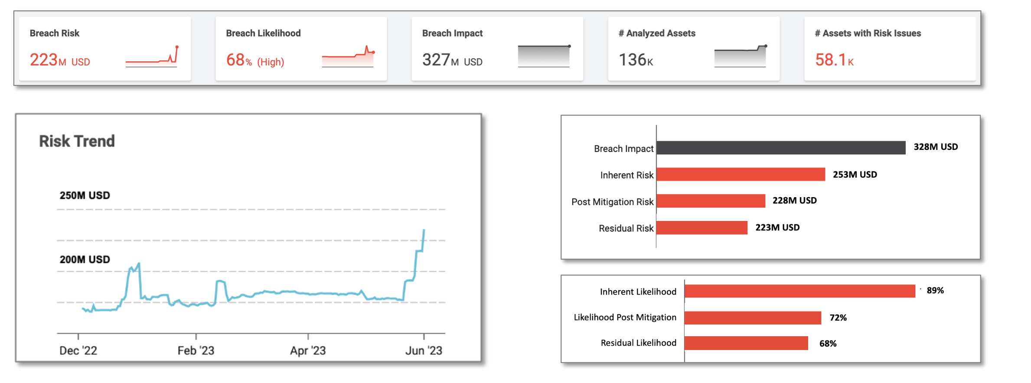
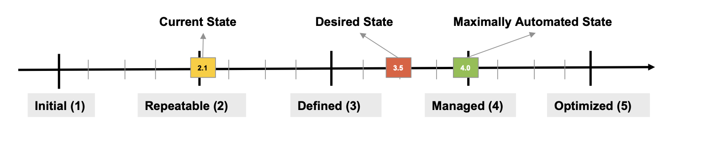
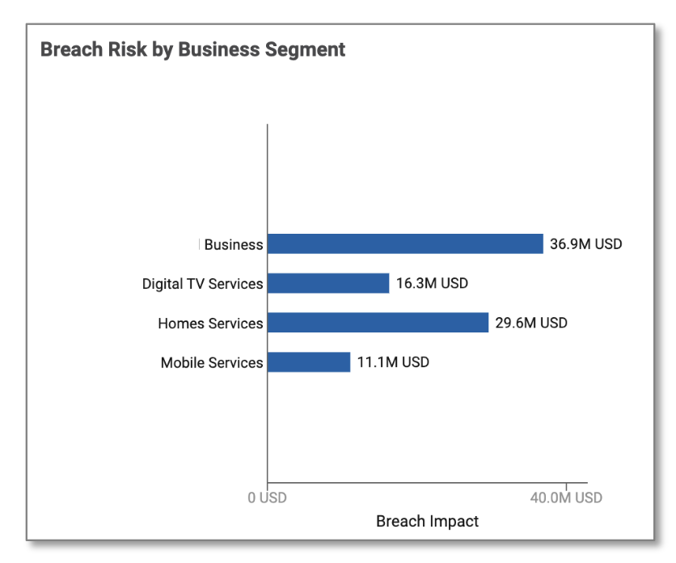
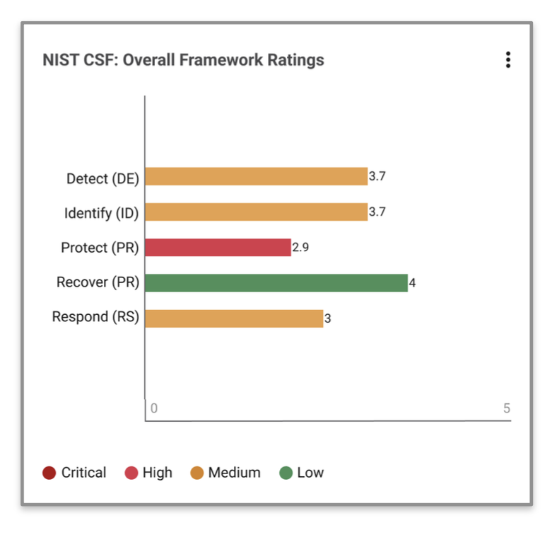
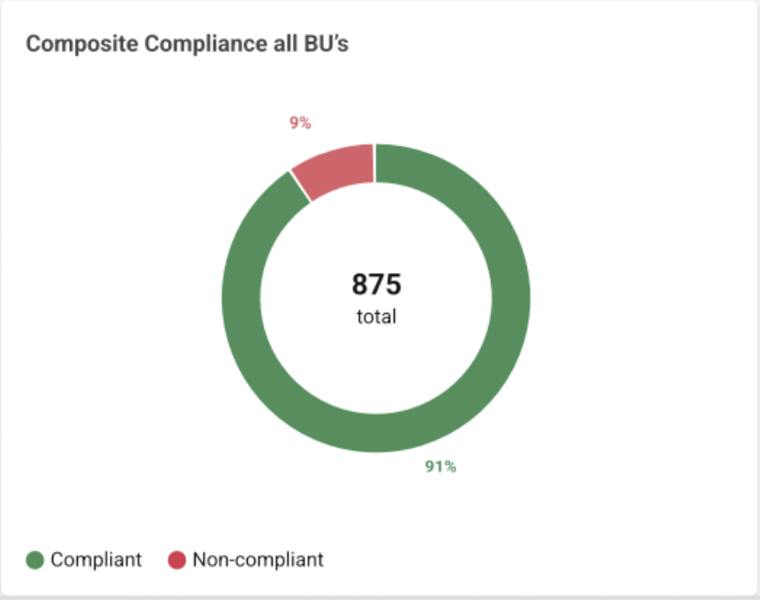
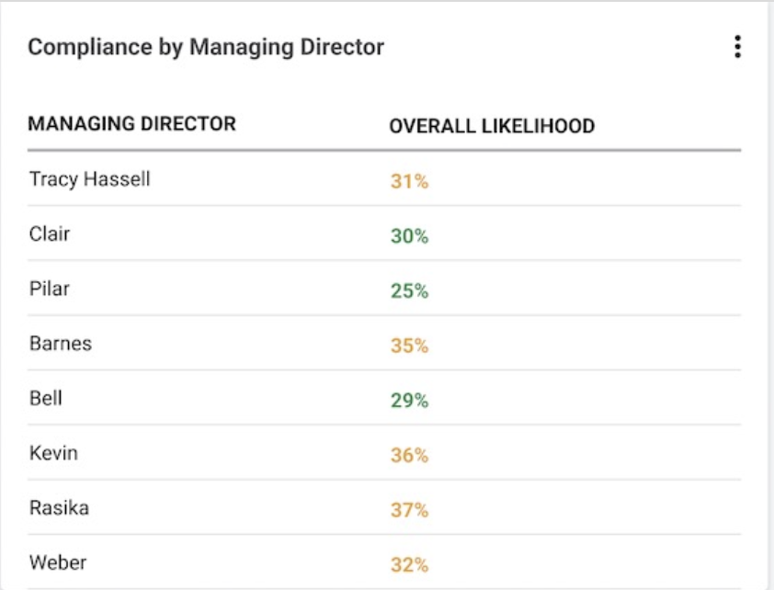
Sample Executive Risk View
Executive Risk View
Operational Risk Dashboard
Asset Inventory
NIST CSF Compliance
SEC Reporting
Board Reporting
Maturity

Slide 14
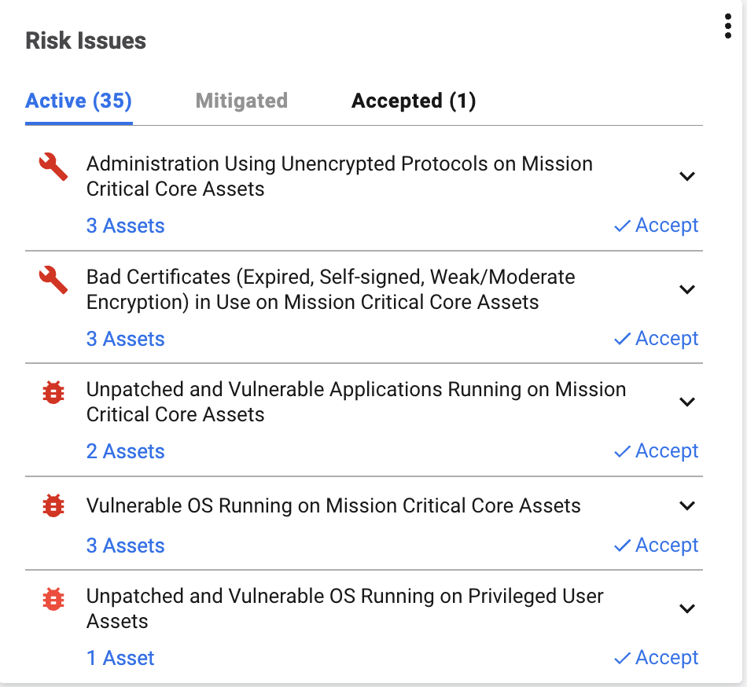
SEC Reports
Executive Risk View
Operational Risk Dashboard
Asset Inventory
NIST CSF Compliance
SEC Reporting
Board Reporting
High Risk Events
Material (2)
Not Material (3)
Reported on 8Ks (1)
Compromised externally facing servers in ATL-DMZ-1 belonging to BU-Consumer.
Materiality Notes
Prepare 8K
X Not Material
Compromised Privileged User Laptop in NYC-HQ belonging to DIVISION-IT-US.
Materiality Notes
Prepare 8K
X Not Material
Risk Trend for 10K Reference
Maturity progress for 10K

Slide 15

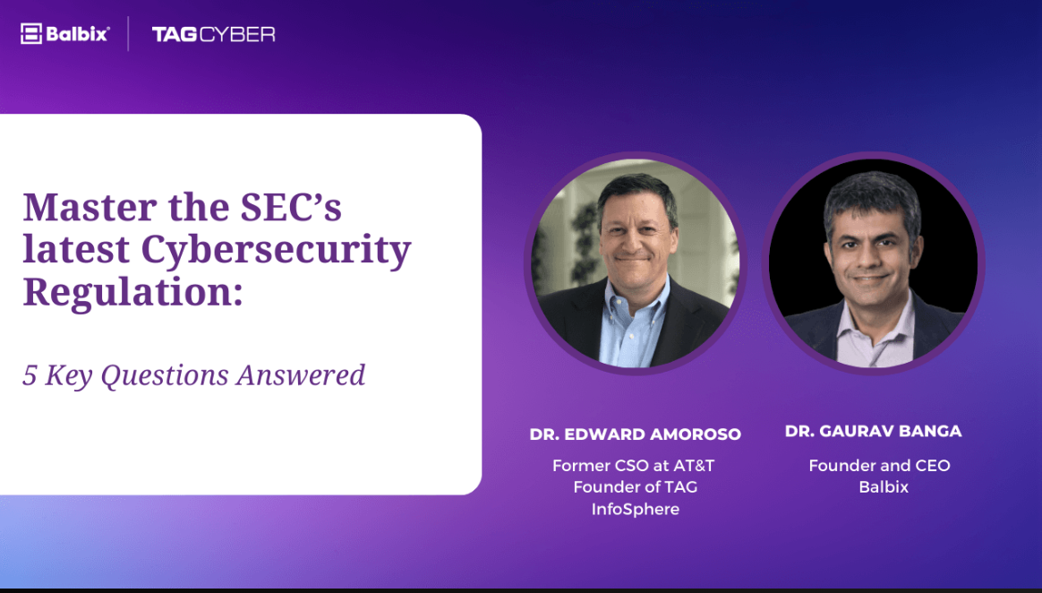
Resources
eBook
A CISOs Guide to the SEC’s Cybersecurity Regulation
Webinar
Master the SEC’s latest Cybersecurity Regulation
Includes examples of materiality definitions and how to prepare for them
What you will learn
What is top of mind for CISOs right now
How do they operationalize the 4-day disclosure rule
What needs to go into 10K and 8K filings
What do mature vs. less mature companies need to do
Download Now
Watch the Video

Slide 16
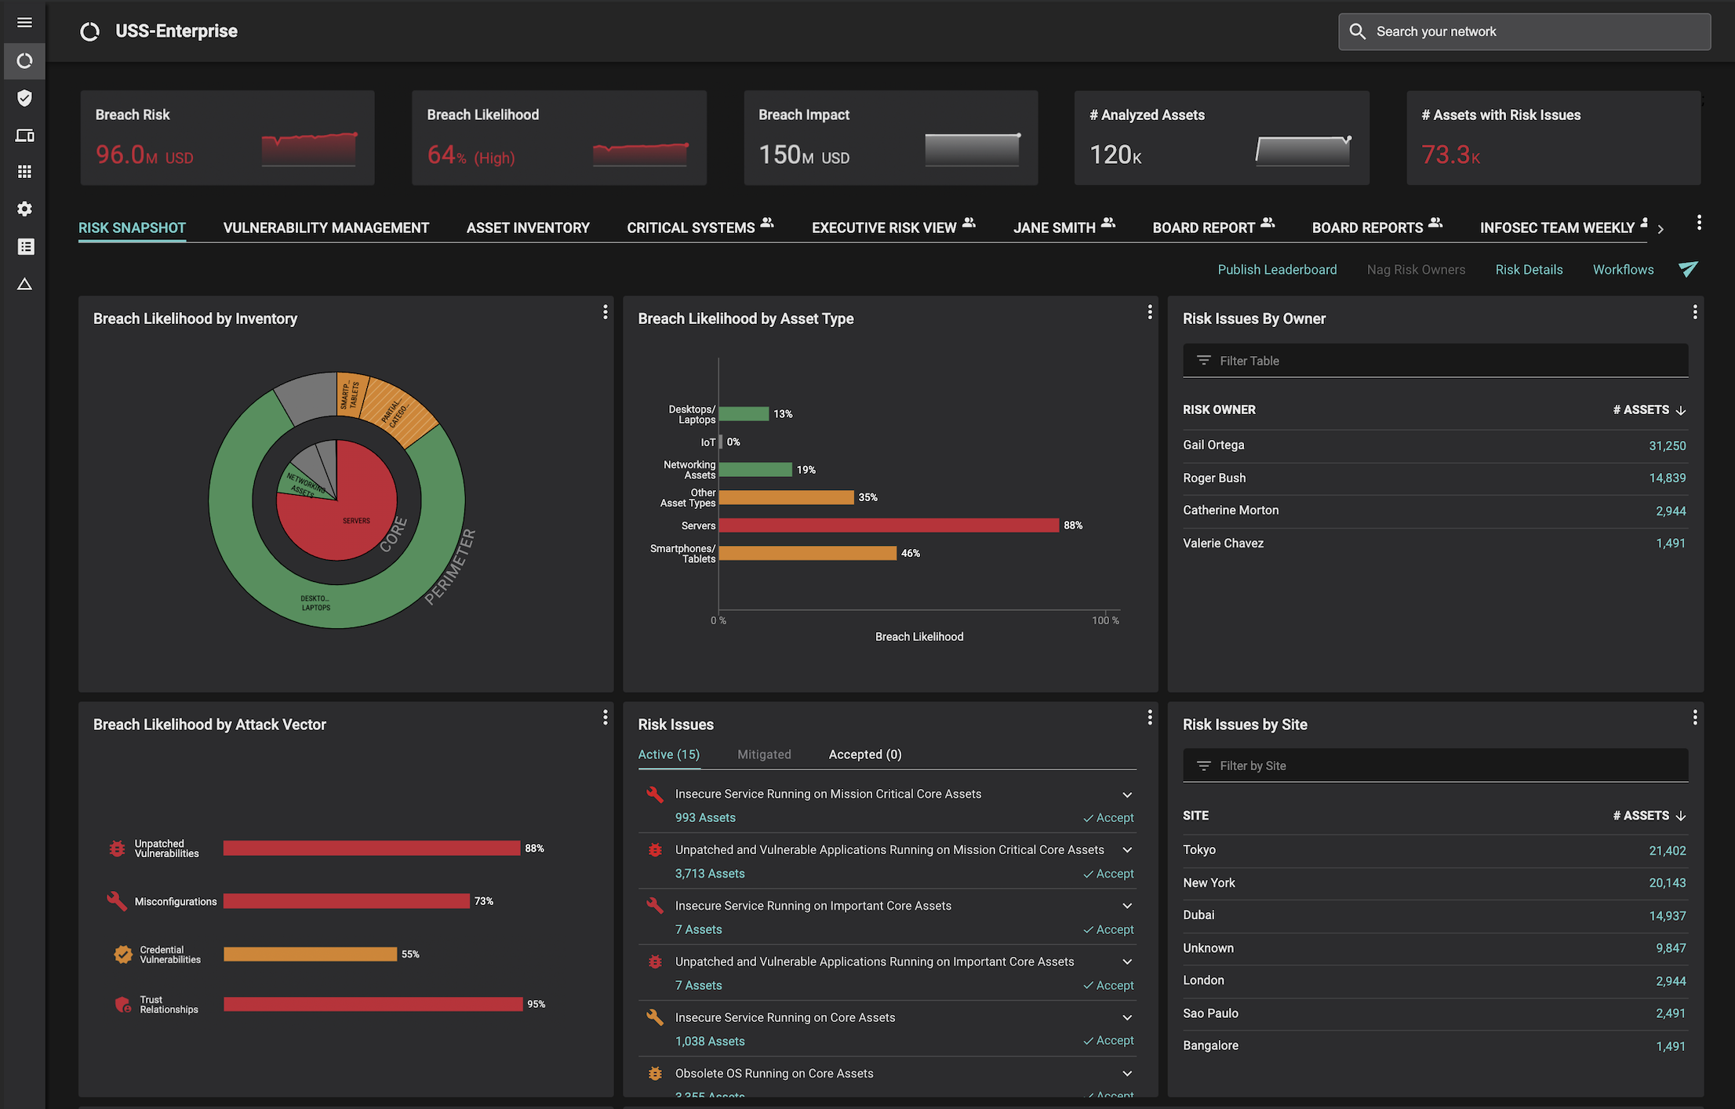
In 30 minutes, we will show how Balbix can provide visibility into all your assets including your material assets.
Additionally, you will be able to quantify your cyber risk in $-terms, traceable to operational metrics and asset attributes driving this risk.
Request a Demo
A single, comprehensive view of cybersecurity posture

