Slide 1

Template for New CISO Presentation to Board Audit Committee or to the Board of Directors

Slide 2
Using this Presentation Template
delete this slide after use
This presentation template will help you organize your first presentation to the board of directors (or the board audit committee). If you have already presented to your board, you should use a different template for recurring CISO presentations which can be downloaded here.
Directions
The core presentation is Slides 7-21. Other slides contain instructions and additional materials.
Customize these slides based on the unique context of your organization and industry.
Look out for the box to know which visualizations are modifiable.
Review the guidance in the notes section below each slide.
Use the slides in the appendix section as needed to augment the presentation.
The risk calculations and visualizations shown in this PowerPoint can be automated with Balbix. You can request a demo here or start your free trial.
Editable

Slide 3
You are telling a story…
delete this slide after use
Remember you are communicating about a complex technical topic with people who typically do not have a deep technical background.
Your goal with this presentation is to help the Board meet its fiduciary duties. In order to do so, you will need to quantify cyber risk in business terms and map these to your key operational projects and metrics. This 1st presentation will play a foundational role in setting you up properly with the Board.
Ultimately what you say will need to inspire the board’s trust and confidence in you and provide assurance that your function is effectively managing information risk.
Your best bet is to tell a compelling and simple story. It is more important to be interesting than to be complete!

Slide 4
What your board cares about…
delete this slide after use
Revenue
Revenue growth and non-revenue objectives
3
things
Cost
Current and future expense
Risk
Compliance, threats to future revenue and brand reputation

Slide 5
Objectives of this 1st Presentation
delete this slide after use
Introduce yourself to the Board
Also re-introduce the Infosec function to the Board
  Explain how cybersecurity risks present board-level business risks
  Set up a framework for future discussions with the Board
Introduce your strategic vision and roadmap for the Infosec function of your organization

Slide 6
Decide How You Want Them to Feel
delete this slide after use
Research shows that human beings, including board members, make most decisions emotionally, and then find data to back up what they already decided.
CISOs often tend to lead with lots of detailed technical security data, and as a result, they risk being unconvincing. You must decide how they want the board to feel as a result of your presentation, and then select the data to back up the emotional arc of the story.
Consider:
  Are you presenting good or bad news? Do you want the board to feel happy about the progress Infosec is making? Or is this bad news because you don’t have funding for everything that absolutely needs to be done?
  How happy do you want them to feel? Excited because cybersecurity posture is indeed better? Mildly concerned that some risks are manifesting but you have them under control? Or deeply concerned because there are “someone might go to jail-level” security holes?
Notes:
Reference for the emotional decision making of humans:
Thinking, Fast and Slow, Daniel Kahneman
https://en.wikipedia.org/wiki/Thinking,_Fast_and_Slow
The main thesis of this book is that of a dichotomy between two modes of thought: "System 1" is fast, instinctive and emotional; "System 2" is slower, more deliberative, and more logical. The book delineates rational and non-rational motivations/triggers associated with each type of thinking process, and how they complement each other, starting with Kahneman's own research on loss aversion. From framing choices to people's tendency to replace a difficult question with one which is easy to answer, the book summarizes several decades of research to suggest that people have too much confidence in human judgement.
Daniel Kahneman was awarded the 2002 Nobel Prize in Economics for his research.

Slide 7
Don’t forget the data
delete this slide after use
While it is important to lead with emotion and tell a story, it is very important to follow with data!
Many CISOs cannot quantify and equate cyber risk in dollars and cents of expected loss.
Remember the common currency that everyone understands is money. If you speak in relative terms, like high, medium or low risk your board member has no real idea if your definition of “medium” is ”an acceptable level of risk”. When you quantify in money terms, e.g., ransomware is a $50M risk item, this becomes easy.
Notes:
Reference:
Storytelling with Data: A Data Visualization Guide for Business Professionals 1st Edition
by Cole Nussbaumer Knaflic
https://www.storytellingwithdata.com/books
https://www.amazon.com/gp/product/1119002257

Slide 8
OUTLINE OF YOUR PRESENTATION
delete this slide after use
This presentation template is divided into three sections designed to earn the Board’s trust and to provide a foundation for future CISO presentations to the board.
Infosec as a Board-Level Topic
Introducing Cyber Risk
& Infosec Framework
Infosec Strategic Roadmap & Metrics
Explain how you think about Infosec as a board-level topic. Make a compelling case that cybersecurity and compliance risks pose a critical business risk, and your board presentations are designed to help the Board understand these risks and provide oversight of risk management.
Provide a general overview of how the organization manages information risk. Present the concept that managing risk is everyone’s job, not just the CISO’s.
Introduce your Infosec framework to establish shared vocabulary and facilitate future discussions about cyber maturity, attacks/incidents, mitigation plans, and cyber risk quantification.
Present Security’s current state against your security framework and lay out your vision and roadmap for improvement.
Establish metrics and supporting data that you will present to track progress towards the annual or quarterly objectives agreed upon with the Board.

Slide 9
Cyber Risk Update
for
<Company X> Board of Directors
October 17, 2021
Add Your Logo Here
Notes:
Modify this slide to add your organization’s name and logo.
The date field is auto-updating. If you are preparing your slides for a specific date, you may want to change that.

Slide 10
ABOUT ME
[insert photo]
My Experience
XXX
YYY
ZZZ
Elizabeth Chen-Reddy
Chief Information Security Officer
Liz.ChenReddy@company.com
Education and Certifications
Degrees
Certifications

Slide 11
Infosec as a Board-Level Topic
AGENDA
Overview of Cyber Risk Management
Infosec Strategic Roadmap and Performance Metrics

Slide 12
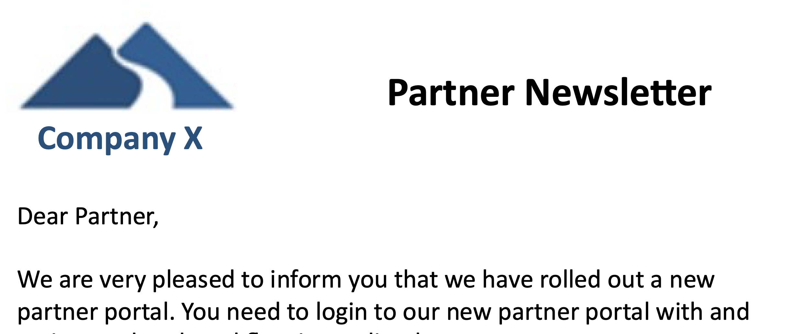






RECENT ATTACKS IMPACTING COMPANY X
eCommerce
Brand Impersonation
Website Defacement
Workforce
90-95%
Exec Phishing Uptick
Insider Threat – Malaysia OT
Infrastructure & Supply Chain
IT Operations
Supply Chain
Supply Chain

Slide 13
EVERYTHING HAS CHANGED
In the last 12 months, there has been an exponential increase in the speed and intensity of attacks, especially targeting the infrastructure and manufacturing segment.
Mean Time of Arrival of New Exploitable Vulnerabilities
Cyber Risk
60 days
$50M
30 days
$25M
2019
2020
2021
2019
2020
2021
Editable
Notes:
This slide is useful when you want to highlight a shift or change in industry conditions and explain to the board why the cybersecurity measures that were “good enough” in the past are no longer cutting it.
You can substitute your company’s values for risk in the figure on the right.

Slide 14
INFOSEC MANAGES BUSINESS-LEVEL RISK
Cyber Breach Risk
Compliance Risk
Strategic Risk
Operational Risk
Financial Risk
Reputational Risk
A theft of IP leads to bad press and long term value loss
A ransomware attack leads to downtime and loss of revenue
A compliance violation leads to a big fine and bad press
Loss of customer data results in bad press and harms customer trust.
Notes:
Customize this slide with ‘bad outcomes’ that are specific to your organization.
Use this slide to make the connection between information and compliance risk and Board-level business risks. It is very important that the Board understands that your presentations are centered around managing business risks that can harm the organization’s strategic objectives rather than around low-level technical details that do not merit Board-level concern.

Slide 15
THE BOARD’S ROLE IN CYBER RISK OVERSIGHT
5 Principles of Effective Cyber Risk Oversight: Guidance by National Assoc. of Corporate Directors
1
Boards should approach cybersecurity as an enterprise-wide risk management issue, not just an IT issue
2
Boards should understand the legal implications of cyber risk as they apply to the company’s specific circumstances
3
Boards should have adequate access to cybersecurity expertise, and discussions about cyber-risk management should be given regular and adequate time on the board meeting agenda
4
Boards should set the expectation that management will establish an enterprise-wide cyber-risk management framework
5
Board-management discussion about cyber risk should include identification of which risks to avoid, accept, and mitigate or transfer through insurance, as well as specific plans
Source: National Association of Corporate Directors, Cyber-Risk Oversight Handbook, 2020
Notes:
Note: This slide uses the National Association of Directors’ guidance because it is broadly applicable across industry. Chat with your CEO to understand if your Board follows a different set of guidelines, and then change this slide appropriately.
Information Sources:
National Association of Corporate Directors: https://www.nacdonline.org/cyber
U.S. Securities and Exchange Commission: https://www.sec.gov/spotlight/cybersecurity.shtml

Slide 16
Infosec as a Board-Level Topic
AGENDA
Overview of Cyber Risk Management
Infosec Strategic Roadmap and Performance Metrics

Slide 17
THREE LAYERS OF INFORMATION RISK MANAGEMENT
Layer 3. Internal Audit
Internal Audit provides the final assurance that information risks are being managed within the organization’s risk appetite.
Internal Audit
Layer 2. Risk Management
Legal
HR
Responsibilities:
Mapping assets to risk owners
Identifying and quantifying known and emerging risks
Setting up and facilitating risk management workflows
Information Security
Compliance
Privacy
Business Segment
Business Unit
Layer 1. Risk Owners – in IT or in the Business Units
Responsibilities:
Owning and managing risks, e.g., patching software
Maintaining effective security controls
Making daily risk management decisions
Site
Notes:
The goal of this slide is to make is that the Board understands the Infosec team leads a broad cross-functional risk management effort. Cybersecurity is not simply “the Security team’s problem.”
If you do not have a formal Internal Audit function at your organization, you should merge Layers 2 and 3 and change the title of this slide.

Slide 18
OUR INFOSEC FUNCTION IN DETAIL
CISO and Deputy CISO
Manage Information Security Risk
Manage Compliance and 3rd Party Risks
Interact with CEO and Board
Manage Incident Response
Manage Security Architecture
Respond to Regulatory Requirements
Manage Data Classification
Risk Management Strategy
Monitor Systems and Events
Manage Vulnerabilities and other risk items
Maintain Records Management and E-Discovery
Manage Business Continuity and Disaster Recovery Plans
Drive Ownership And Accountability
Operate Security Controls
Evaluate and oversee deployment of new security tools
Manage Data Privacy
Manage Employee Awareness & Training
Manage Information Security Budget
Manage Third-Party Risks
Manage Information Security Vendors
Hiring and Training
Measure Metrics and Performance
Notes:
Customize this slide to represent the full set of activities and sub-activities performed by your Infosec team, and the corresponding responsibilities.

Slide 19

WE USE THE NIST CYBERSECURITY FRAMEWORK
Uses of the NIST Cybersecurity Framework
Understanding and communicating security status
Prioritizing infosec activities
Improving our cybersecurity program
Updating the Board on the organization’s cybersecurity posture
Understanding breaches in the news
Aligning regulatory requirements with broader risk management activities
CISO
The Board
Risk Owners
Notes:
Use this slide to set up the security framework you will describe in the next few slides.
Ensure that Board members understand that the security framework is not just how you implement Infosec at your organization but will also be used in future Board conversations to create consistency, promote understanding, and ensure sufficiently high-level discussions.

Slide 20
WE USE THE NIST CYBERSECURITY FRAMEWORK
Capability
Description
Metrics
Identify
% Visibility, Breach Impact ($s) of Assets and Scenarios
What processes and assets need protection?
Protect
Implement appropriate safeguards to ensure protection of the enterprise’s assets
Risk in $s
Detect
Implement appropriate mechanisms to identify the occurrence of cybersecurity incidents
Mean-time-to-detect
Respond
Develop techniques to contain the impacts of cybersecurity events
Max-time-to-respond
Recover
Implement the appropriate processes to restore capabilities and services impaired due to cybersecurity events
Max-time-to-recover
Notes:
Use this slide to teach the Board the NIST cybersecurity framework, or another framework if you use something else.
Explain how unlike other approaches, your approach to the framework involves a hard metrics. These metrics help you a) quantify cyber risk in business language of $s (or some other currency) and b) map cyber risk to operational which guide better operational cybersecurity and risk management practices.
It may be valuable to spend extra time here for Q&A to ensure full comprehension by the board members.

Slide 21
LEARNINGS FROM THE COLONIAL ATTACK
Capability
Colonial
Our Organization
Identify
Colonial did not have an up to date inventory of their users and assets and they had big gaps in their vulnerability assessment program.
We still have some gaps in our cybersecurity visibility and vulnerability management program but have made good progress in recent months.
82% visibility
Protect
Attackers breached Colonial’s network through a compromised credential and were able to quickly penetrate deep due to a flat network.
We continue to invest in protective controls. This year we are deploying MFA and EDR. We are reducing mean-time-to-patch below 30 days.
Risk:
$37M
Detect
Colonial’s detection capabilities were hampered by their lack of visibility into user activity and the connections between their IT and OT networks.
We have invested heavily in our monitoring capabilities. Our 24x7 SOC keeps a vigilant eye out for anomalies in traffic patterns.
Detect Time:
50 min
Respond
Colonial did not have a good response plan for attacks to the IT network. They had to shut down their OT network as a precautionary measure.
In case of breach, we have a detailed plan to limit damage, contact the authorities and inform our customers.
Response Time:
4 hours
Recover
Notes:
Use this slide to show how your security framework (NIST) can be used to analyze breaches in the news.
A common question Board members ask is, ‘Are we secure? Can this happen here?’ Your logical analysis of the situation, and how it fits in with the overall story you have been telling them will go a long way in earning the board’s trust.
This might also be the time to highlight big gaps in your security program and ask for the financial support and mandate you need from the board to close the gap. Quantifying the level of risk in money units will get your point across to the board.

Slide 22
Infosec as a Board-Level Topic
AGENDA
Overview of Cyber Risk Management
Infosec Strategic Roadmap and Performance Metrics

Slide 23
CYBERSECURITY POSTURE PROJECTS
Capability
Initiatives
2021
2022
Identify
Implement continuous cybersecurity posture visibility. Build risk owner’s matrix and update quarterly.
Deploy Balbix
Asset Criticality Analysis
Build risk group hierarchy and assign risk owners
Implement strong identity with adaptive authentication. Improve security hygiene and patching posture. Update email security.
Build Balbix workflows for non-patching risk items
Turn on Okta adaptive auth
Protect
Deploy Okta
Improve Patching Posture using Balbix
Deploy Proofpoint or similar tool
Detect
Incorporate threat feeds in SOC workflows.
Integrate Recorded Future in SOC
Respond
Improve incidence response with automated playbooks
Integrate TBD SOAR platform in SOC
Recover
Review & update business continuity plan every quarter
Review & identify gaps in plan with risk owners
Develop plan update to address gaps
Implement & test plan
Notes:
Use this slide to provide an overview of your Infosec projects, and how they will serve to improve your cybersecurity posture.
Your main objective is to provide assurance that you are effectively managing to your strategic roadmap and to answer questions about the goals. Be prepared to discuss any project you list on this slide.

Slide 24
CYBERSECURITY KPIs: RISK, LIKELIHOOD & IMPACT
Breach Risk Trend
$37M
48%
$77M
$M
Risk
Likelihood
Impact
There is a 48% chance that we will have an impact of $77M from a cybersecurity event this year.
Editable
Notes:
You should substitute your values for Breach Risk, Likelihood and Impact as appropriate. The trend chart can be updated by right-clicking and selecting “Edit Data in Excel”.
It is critical that you use a consistent, data-driven and therefore defensible approach for constructing and populating your risk dashboard.
These widgets can be also automatically generated by Balbix.
Remember to lead with emotion when presenting these numbers. Most members of the board will take the cue from how you present this data interpret these numbers as good, neutral or bad. $37M of cyber risk may be completely acceptable or not depending on the size and risk appetite of your business.
You must resist the urge to sugarcoat things and paint an overly optimistic (“all green”) picture of cybersecurity posture. Experienced board members will see right through this.

Slide 25
RISK BY BUSINESS UNIT AND ATTACK TYPE
Risk Snapshot by Business Unit
Breach Risk Trend
Breach Likelihood by Attack Type
Editable
Notes:
You should substitute your business unit names and values. The two bar charts can be updated by right-clicking and selecting “Edit Data in Excel”.
All three widgets can be automatically generated by Balbix by analyzing data from your IT, cybersecurity and business tools or from your cybersecurity data lake.
This is the slide where the board gets to really understands the amount of risk you are carrying. Again $17M of risk in the “Industrial” business unit may be completely acceptable or not depending on your overall business situation. Make sure you provide appropriate commentary with the appropriate emotion to help the board interpret these numbers as what they mean to you.
The Trend widget is the most important widget on this slide. Trends in general help you tell the story f your cybersecurity program. Board members like trends.

Slide 26
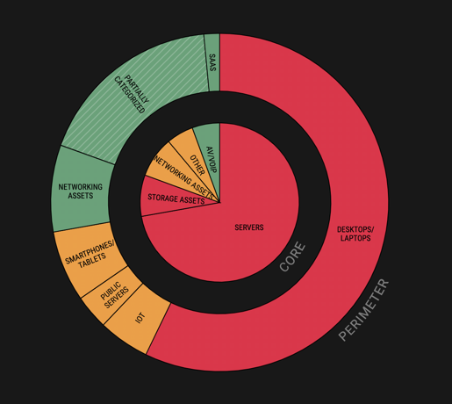
WE USE THIS WIDGET TO PROVIDE A BIRD’S EYE VIEW OF CYBERSECURITY POSTURE
The outer ring is everything “Internet Facing”. This is where attacks begin before burrowing into the core.
The inner circle is the core, properly behind the corporate “firewall”. This is where most of our valuable information and critical systems are.
Red means high likelihood of breach. Green and Orange is better.

Slide 27
E.g., EFFECTIVENESS OF PROTECTIVE CONTROLS
Notes:
Tell the board how this slide shows the value of your currently deployed controls. The picture on the left is what your organization would look like without the controls. The trend line shows progress in overall effectiveness of your controls.
These types of data-driven visuals inspire your Board’s trust because they realize that your story is based on facts, and your decisions are based on data.

Slide 28
CYBERSECURITY KPIs: MEAN-TIME-TO-RESOLVE
continuous monitoring
Indicators of vulnerabilities, attack or compromise
Minimize exposure and Risk by remediating vulnerabilities and risk items at high velocity
evaluate and dispatch
Automate
contain
Notes:
Tell the board how ultimately the only thing that matters is speed of containment of risk.
Your overall objective is to minimize the window of opportunity for attackers by deploying protective controls and maximally automating the mitigation of any vulnerability as it becomes known,
But occasionally, an attack will slip through and your goal is to detect such situations as quickly as possible and then contain the situation.
Investing in automation is key.

Slide 29
STRATEGIC INITIATIVE: AUTOMATION
Industry avg. for MTD is 15 days, MTTR is 120+ days
Our MTD is now <1hr, MTTR is 6 days
Identification of vulnerable and risky assets
Our exposure
Emergence of Risk, e.g., newly discovered vulnerability
Resolution
Automating identification, evaluation and resolution of cyber-risk
t_{X}
t_{D}
t_{R}
time
Mean Discovery Time (MDT)
Mean Time To Resolve (MTTR)

Slide 30
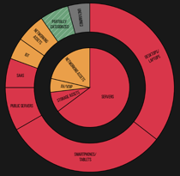
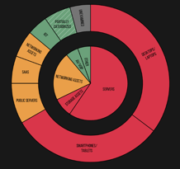
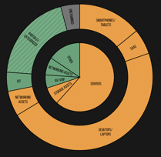
CYBERSECURITY POSTURE GOALS
Breach Risk Change and Target State
Q4 ‘20
Today
Target for Q2’22
Notes:
This might be the slide that your board members remember the most. Things are getting greener and yellower, so that is good.
This widget can be automatically generated by Balbix.

Slide 31
Q & A

Slide 32
APPENDIX SLIDES

Slide 33
If you found these slides useful…
delete this slide after use
Balbix can help you with many critical pieces of your Infosec program.
The Balbix platform uses AI to help discover and analyze your assets and attack surface to Identify areas of greatest risk. This is foundational to effective capabilities for Protect , Detect , Respond and Recover .
Balbix will automatically and rigorously quantify your cyber risk in $s.
Balbix also enables you automate critical elements of your cybersecurity program and quantify changes in risk as you improve your cybersecurity posture. The next few slides has some additional examples of this.
Start your free Balbix trial >>>

Slide 34
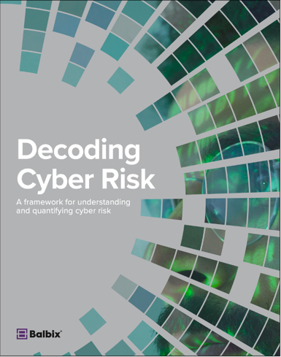
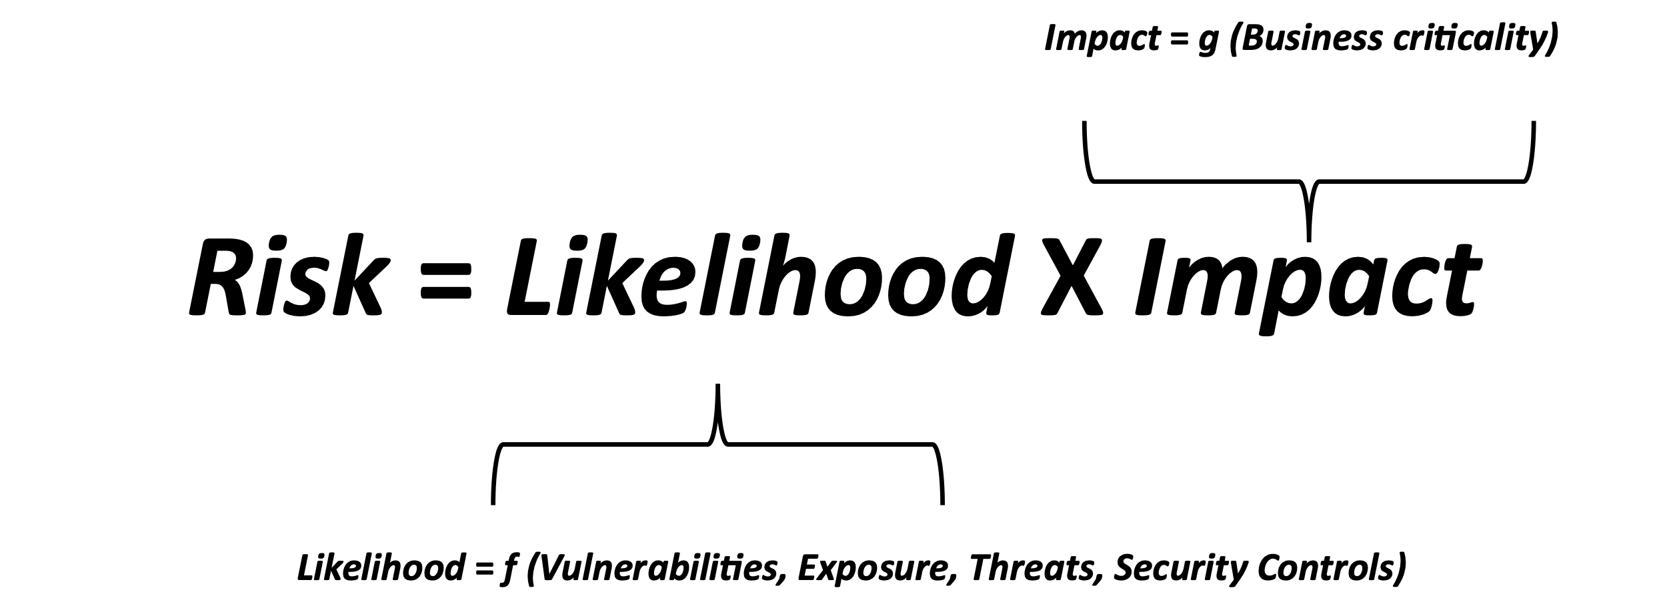
CYBER RISK QUANTIFICATION
delete this slide after use
You can learn more about how to rigorously estimate your cyber risk in money units by analyzing data from your various cybersecurity, IT and business tools.
Download this eBook at https://www.balbix.com/resources/how-to-calculate-your-enterprises-breach-risk/

Slide 35
IDENTIFY
delete this slide after use
Maturity Level
Incomplete or manual inventory
Incomplete and non-continuous vulnerability assessment
Continuous asset discovery and inventory
Continuous vulnerability assessment across 100+ attack vectors incl. people
Can quantify the impact of deployed mitigations on risk
Previous level capabilities
New vulnerabilities and risk items are automatically mapped to risk owners
Risk owners are notified about risk items that require action
Previous level capabilities
Risk is understood in units of currency
Different mitigation scenarios are simulated and compared
Partial
Informed
Repeatable
Adaptive
Balbix can help your organization implement all capabilities that are needed for Adaptive Level Maturity for Identify.
Start your free Balbix trial >>>
Notes:
Identify is the foundational layer in the NIST cybersecurity framework. You cannot protect what you don’t know about!
The 1st Identify capability that your cybersecurity program needs is: automatic and comprehensive discovery of enterprise assets (devices, applications, services and users) across on-prem, cloud and 3rd parties.
The 2nd piece is continuous assessment for vulnerabilities and risk items for all enterprise assets (including people) across 100+ attack vectors.
The 3rd capability you need is mapping risks and vulnerabilities at the device-network level to business units and risk owners, and quantifying risk in money terms.
Because of the size and complexity of the attack surface, “Identify” is not a human scale problem anymore. https://www.balbix.com/product-overview/why-balbix/
We built Balbix specifically to harness the power of advanced AI and provide these capabilities for you. You can request a demo (https://www.balbix.com/request-a-demo/) or start your free trial. (https://www.balbix.com/free-signup/).

Slide 36
PROTECT
delete this slide after use
Maturity Level
“Partial” maturity level for Identify capabilities
Some basic protections in place such as anti-virus and Internet firewall
“Informed” or higher maturity level for Identify capabilities
EDR and VPN deployed, security awareness training
Continuous vulnerability management for the majority of organization’s assets
Previous level capabilities
Strong Identity
Continuous security & risk training of people
Partially segmented network
Previous level capabilities
Proactive management of vulnerabilities and risk items
Zones and Adaptive Trust
Periodic penetration testing of defenses
Partial
Informed
Repeatable
Adaptive
Balbix can help your organization implement important Identify and Protect capabilities (underlined above) that are needed for increased maturity of Protect
Start your free Balbix trial >>>
Notes:
Your 1st line of Protect capabilities is:
EDR, firewall and VPN
Continuous vulnerability management
Balbix implements continuous risk-based vulnerability management OR can integrate with your existing vulnerability tool.
As you make progress in improved Protect capabilities, Balbix will automatically detect your new mitigations and compensating controls (such as EDR) and update your risk calculation to take into account these new capabilities.
Balbix can also generate continuous dashboards and reports that tell each risk owner what open vulnerabilities, risk items and tasks that they need to worry about. Risk owners can be compared against each other and incentivized to be at the top of the cybersecurity leaderboard. This can go a long way in developing a culture of shared risk ownership and driving down risk.

Slide 37
DETECT
delete this slide after use
Maturity Level
“Partial” maturity level for Identify capabilities
Security Operations Center (SOC) not implemented
“Informed” or higher maturity level for Identify capabilities
Basic SOC with partial monitoring coverage of security events from organization’s assets
Previous level capabilities
Advanced SOC with comprehensive monitoring and detect coverage of security events
Previous level capabilities
Proactive threat hunting capabilities
Prioritization of SOC activities based on Risk
Partial
Informed
Repeatable
Adaptive
Balbix can help your organization implement important Identify and Detect capabilities (underlined above) that are needed for increased maturity of Detect
Start your free Balbix trial >>>
Notes:
Balbix contains risk context for all your assets including software version configuration, open vulnerabilities, threats, exposure, compensating controls and asset criticality information.
This information can be accessed by your SOC team and used to prioritize their analysis tasks.

Slide 38
RESPOND
delete this slide after use
Maturity Level
“Partial” maturity level for Identify capabilities
No formal Respond Plan
“Informed” or higher maturity level for Identify capabilities
Manual Respond Plan for critical organization assets
Previous level capabilities
Automated Respond Plan for all enterprise assets
Periodic review and update of Respond Plan
Previous level capabilities
Optimized Respond Plan for all enterprise assets
Partial
Informed
Repeatable
Adaptive
Balbix’s Identify capabilities (underlined above) are foundational to implement increased maturity of your Respond Plan
Start your free Balbix trial >>>
Notes:
Balbix’s Identify capabilities are foundational to implement increased maturity of your Respond Plan.

Slide 39
RECOVER
delete this slide after use
Maturity Level
“Partial” maturity level for Identify capabilities
No formal Recover Plan
“Informed” or higher maturity level for Identify capabilities
Manual Recover Plan for critical organization assets
Previous level capabilities
Automated Recover Plan for identified critical assets
Periodic review and update of Recover Plan
Previous level capabilities
Recover Plan optimized for timely restoration of assets and functions based on business criticality
Partial
Informed
Repeatable
Adaptive
Balbix’s Identify capabilities (underlined above) are foundational to implement increased maturity of your Recover Plan
Start your free Balbix trial >>>
Notes:
Balbix’s Identify capabilities are foundational to implement increased maturity of your Recover Plan.

Slide 40
CYBERSECURITY POSTURE AUTOMATION
delete this slide after use
Owner Review
Manual or Automated Fix/Mitigation Steps
Automatic Validation
Global Threat & Vulnerability Data
Dashboards & Reporting
Per-owner Prioritized list of Vulnerabilities and Risk Items
Accept Risk for some issues and document reasons
Prioritized list of Vulnerabilities and Risk Items
Assign to another owner
Automatic Asset Inventory
Continuous Assessment of Vulnerabilities and Risk Issues
Evaluation of Vulnerabilities and Risk Issues
Dispatch to Risk Owners
Periodic Review of Exceptions
Balbix sensors and other IT and Cybersecurity Data Sources
Some risk Issues are automatically accepted based on specific enterprise context
Notes:
Here is a picture that shows how automated cybersecurity posture works.
Starting from the left, we first build and maintain automatic asset inventory.
We also perform continuous assessment of vulnerabilities, we can bring in the global threat information, and then based on the business and security context that we have in Balbix, we evaluate those vulnerabilities, we prioritize them, we suppress certain of them based on mitigations we might have, what things you may have decided to postpone.
Then we automatically dispatch prioritized lists of vulnerabilities and risk items to the various risk owners. Until this point onwards, everything is automated.
Every one of the owners get their own dashboards with their own set of prioritized issues, kind of like a mini-organization. Each issue has to be either remediated, mitigated or accepted.
Owners can configure different groups of assets, e.g., auto-update assets, test-and-patch assets and do-not-patch assets, and each of these groups is handled differently from a automation perspective.
Balbix is also continuously validating vulnerabilities and risk items. Metrics is automatically updated in the Balbix dashboard, and reports are automatically triggered for various stakeholders.
Deployment of Balbix will enable you to drive mean-time-to-resolve down to hours or days from weeks and months.

Slide 41
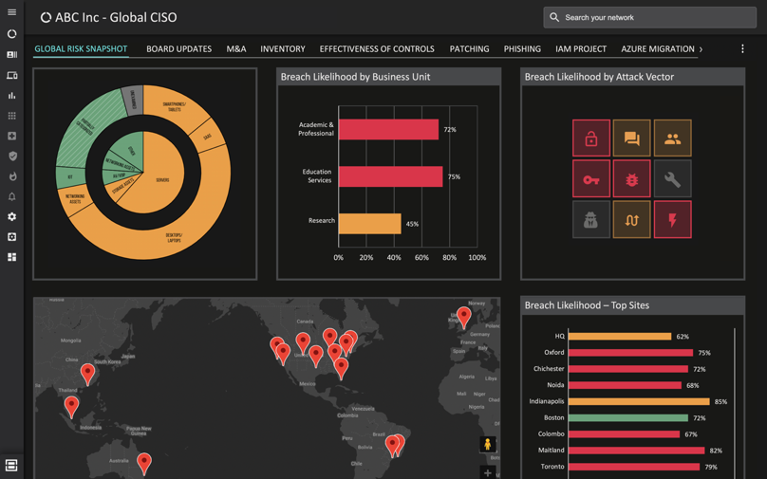
LEARN MORE ABOUT BALBIX
In 30 minutes, we will show how Balbix can help you automate your cybersecurity posture.
With Balbix, you will use AI, automation and gamification to discover, prioritize and mitigate your unseen vulnerabilities at high velocity.
You will also be able to quantify your cyber risk in $-terms, traceable to operational metrics and asset attributes driving this risk. You will be presented with practical actions you can take to mitigate this risk.
Request a Demo
https://www.balbix.com/request-a-demo/
A single, comprehensive view of cybersecurity posture

Slide 42
Good Luck!
delete this slide after use
Start your free Balbix trial >>>

