Slide 1
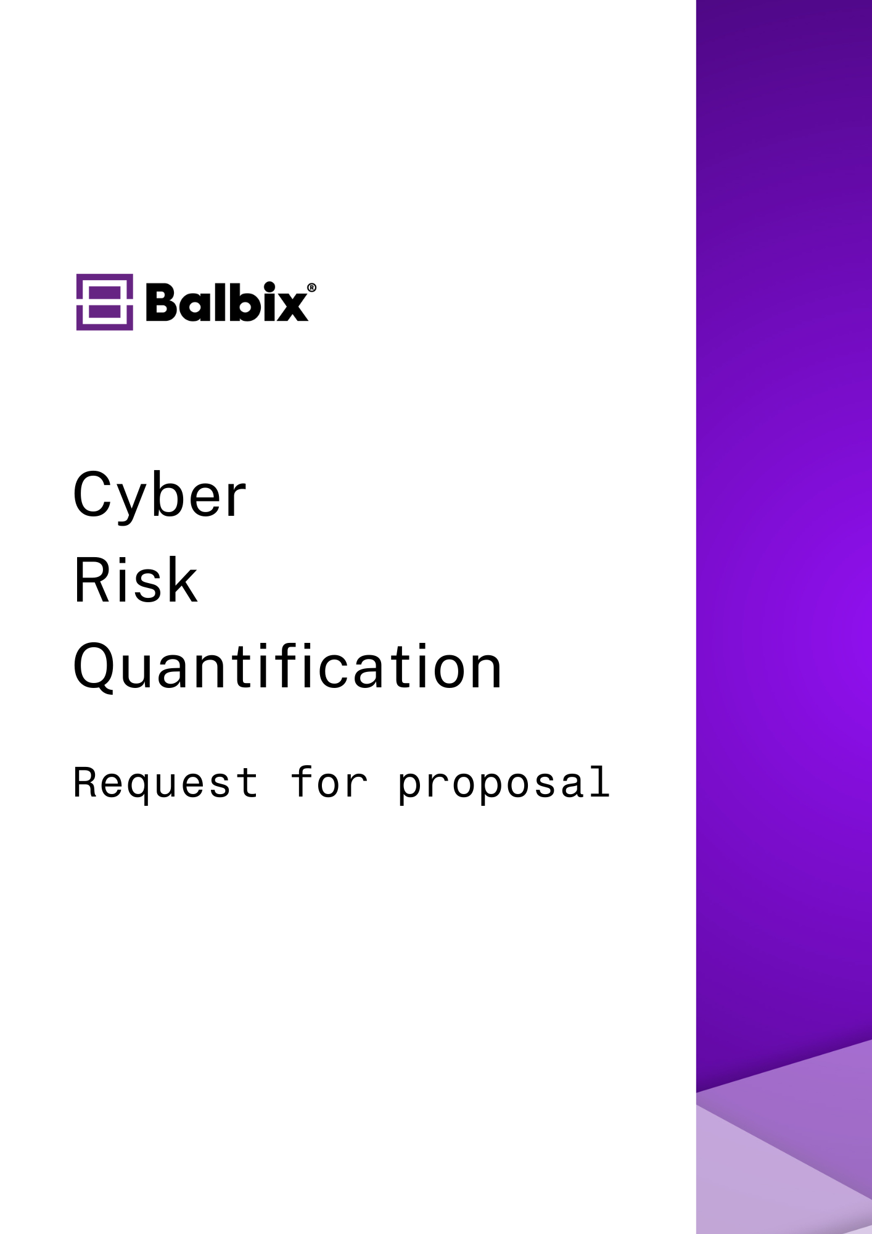

Slide 2
Content | Page No.
Initiating Company Profile | 3
Schedule & Submission Instructions | 4
Vendor Profile | 5
Section A: Cyber Risk Scenarios | 6
Section B: Cyber Risk Data & Assumption | 7
Section C: Quantified Cyber Risk Model | 8
Section D: Reporting & Dashboarding | 10
Section E: Actionability | 12
Section F: Inbound Integrations | 14
Section G: Outbound Integrations / Data Exports | 16
Section H: Platform | 17
Section I: Unified and Correlated Asset Inventory | 18
Section J: Unified and Correlated Software Inventory | 19
Section K: Risk-Based Vulnerability Management | 20
2

Slide 3
Initiating Company Profile
<To be filled by RFP issuing company>
Company Background
<include the background and the details of the company requesting the RFP>
Project Overview and Objectives
<provide a detailed description of the project's purpose, define what's in scope/out of scope, and specify the objectives of the RFP>
Project Owners:
<Provide name, role, and contact details of the key project stakeholders>
Full Name | Role | Business Email
3

Slide 4
Schedule & Submission Instructions
<To be filled by RFP issuing company>
Schedule of Events
Sample tasks included below
Task | Description | Due Date
RFP distribution | Release the RFP to potential vendors with experience in CRQ
Deadline for vendor questions | Set a deadline for vendors to submit any queries regarding the RFP
Answers for vendor questions | Provide detailed responses to the vendors' questions to clarify the RFP requirements
Notification of shortlisted vendors | Specify the deadline for vendors to submit their proposals
Vendor presentations | Invite shortlisted vendors to present their CRQ approach and solution.
Vendor PoC | Evaluate vendor presentations, proof of concept demonstrations, and additional materials.
Vendor selection | Select the vendor that best meets the requirements.
Project commencement | Begin the deployment with the chosen vendor
Project completion | Mark the completion of the project
4

Slide 5
Vendor Profile
<This and subsequent pages are to be filled by the vendor>
This section captures essential information about the vendor's organizational history, strategic direction, market position, and other related dimensions.
Question | Vendor Response
When was your company established?
How long has your product been generally available for purchase?
Describe the vision and direction of your company
Number of existing customers
Number of employees
Include a high-level overview of your product's roadmap over the next 12 months
Do you maintain alliances with other information technology vendors? If so, which ones?
Links to case studies or examples where your product has successfully helped businesses quantify and mitigate cyber risk?
What training and support do you offer to ensure your product's successful implementation and ongoing usage?
What is the pricing structure for your product? Please include details on tiered pricing, additional costs for features or services, and options for scalability as organizational needs change.
5

Slide 6
Section A
Cyber Risk Scenarios
This section focuses on the vendor's ability to model and analyze diverse cyber risk scenarios. It assesses how effectively the tool can simulate potential security threats and their impact on various aspects of the organization.
ID | Requirement | Vendor Response (Yes/No) | Vendor Comments
A-1 | Flexible cyber risk scenario scoping covering organizational units, applications, material assets, and threats in focus, e.g., ransomware
A-2 | Dynamic scenario updates based on environment and threat landscape changes
A-3 | Self-service risk scenario scoping suitable for risk or cybersecurity analysts
A-4 | Pre-defined risk scenarios provided out-of-the-box
A-5 | Ability to benchmark risk scenarios and trends over time by appropriate organizational groupings
6

Slide 7
Section B
Cyber Risk Data & Assumption
This section examines the vendor's approach to leveraging and integrating data for cyber risk quantification. It focuses on the methodologies to source, process, and utilize data to build an accurate and dynamic risk model.
ID | Requirement | Vendor Response (Yes/No) | Vendor Comments
B-1 | Utilize existing data from IT, security, and business systems to populate the risk model
B-2 | Support continuous, real-time data ingestion into the platform
B-3 | Ability to address gaps or fidelity limitations of available data sources
B-4 | Fully automated and robust data ingestion process
B-5 | Minimal requirements for manual data input
7

Slide 8
Section C
Quantified Cyber Risk Model
This section delves into the vendor's capabilities in developing a comprehensive and predictive cyber risk model. It focuses on the integration of real-time data and various contextual elements to accurately quantify cyber risks in monetary terms.
ID | Requirement | Vendor Response (Yes/No) | Vendor Comments
C-1 | Real-time and predictive quantitative (monetary) cyber risk model reflective of the current state of the environment
C-2 | The risk model incorporates cybersecurity, IT, and business context
C-3 | The risk model is bottoms-up with asset-level detail and granularity
C-4 | The risk model leverages asset data, including business applications and IT assets, into the risk analysis via existing asset data sources
C-5 | The risk model leverages a unified, normalized, and deduplicated real-time asset inventory as the foundation for defendable risk analysis
C-6 | The risk model incorporates vulnerability data, including vulnerability scan results, security misconfigurations, and control findings, into the risk analysis via existing vulnerability data sources
C-7 | The risk model leverages a unified, normalized, and deduplicated real-time view of all vulnerabilities across the environment
C-8 | The risk model incorporates threat intelligence into the risk analysis, automatically identifying relevant threats via existing threat data sources
8

Slide 9
ID | Requirement | Vendor Response (Yes/No) | Vendor Comments
C-9 | The risk model leverages real-time threat intelligence to adjust risk accordingly
C-10 | The risk model incorporates security control findings into the risk analysis, automatically identifying relevant controls via existing control assessment data sources
C-11 | The risk model utilizes industry standard frameworks such as MITRE ATT&CK to align vulnerabilities, threats, and security controls
C-12 | The risk model incorporates financial loss data in monetary terms, reflecting different types of loss via existing loss data sources
C-13 | The risk model leverages asset-level criticality and business context for bottoms-up computation of breach impact and monetary loss
C-14 | The risk model considers breach likelihood based on vulnerability severity, vulnerability exposure, threats, and mitigating controls
C-15 | The tool handles risk aggregation automatically to avoid double-counting or overstating risk
C-16 | The risk model is fully inspectable to enable analysts and executives to understand and validate the underlying drivers of risk
C-17 | The risk model updates in real-time to incorporate remediated risk issues and vulnerabilities
C-18 | Risk reporting at the enterprise, business organization, business application, or individual asset level
C-19 | Risk Acceptance workflow for management and tracking of accepted risk issues, including Risk Owner and Expiration
9

Slide 10
Section D
Reporting and Dashboarding
This section assesses the vendor's ability to provide dynamic, real-time reporting and dashboarding capabilities.
ID | Requirement | Vendor Response (Yes/No) | Vendor Comments
D-1 | Native, out-of-the-box dashboards and reports across a range of risk scenarios
D-2 | Dashboards update dynamically in real-time to reflect the changing threat environment, risk calculations, and underlying data
D-3 | Native dashboards illustrate risk across different organizational groupings, such as business units, product lines, or geography
D-4 | Native dashboards illustrate risk by the owner to ensure visibility across responsible parties and gamification of risk reduction
D-5 | Easily customizable dashboards to report on the scenarios and insights in scope for individual operational and executive users
D-6 | Native dashboards appropriate for CISO, board of directors, and executive-level audiences
D-7 | Native dashboards appropriate for operational leaders and their teams to identify and drive the best steps for risk reduction
D-8 | Flexible collaboration capabilities for dashboards and reports
D-9 | Flexible views tailored for users with different roles and risk management scope, including risk management, operations analysts
10

Slide 11
ID | Requirement | Vendor Response (Yes/No) | Vendor Comments
D-10 | Ability to support risk assessment aligned with key cybersecurity and industry frameworks such as NIST, CIS
D-11 | Support for cybersecurity risk management and material asset reporting to enable rapid compliance with regulations such as DORA, SEC cybersecurity rules
11

Slide 12
Section E
Actionability
This section evaluates the vendor's ability to translate cyber risk data into actionable insights and strategies. It focuses on the tool's capacity to automate risk prioritization, assign ownership, and provide detailed guidance for effective remediation.
ID | Requirement | Vendor Response (Yes/No) | Vendor comments
E-1 | Automated generation of specific, actionable insights for risk reduction
E-2 | Automatic asset-level assignment of ownership for identified priority risk issues
E-3 | Native risk-based prioritization of the next best steps to reduce risk across any scenario in scope
E-4 | Native workflow to enable drill-downs, investigation, and prioritization of specific security issues affecting risk, including vulnerabilities, misconfigurations, failed controls
E-5 | Detailed, asset-level remediation instructions provided out-of-the-box for addressing prioritized risk issues
E-6 | Native ticketing integrations for dispatching tickets for efficient remediation, along with all detailed information required for asset-level fixes
E-7 | Automatic detection of successful remediation for resolved risk issues, including vulnerabilities, misconfigurations, failed controls
12

Slide 13
ID | Requirement | Vendor Response (Yes/No) | Vendor comments
E-8 | Ability to push application or asset-level risk values to downstream IT and business management systems, such as ServiceNow
E-9 | Executive-level reporting on risk reduction trends and progress by organizational unit
E-10 | Native reporting on the ROI of deployed cybersecurity investments and controls in terms of monetary risk reduction
13

Slide 14
Section F
Inbound Integrations
This section addresses the platform's capability to integrate with various external data sources and solutions. It focuses on the extent and ease of inbound integrations, including automated data ingestion, to enhance the platform's functionality and data accuracy.
The platform supports inbound data integrations with the following categories of solutions out-of-the-box via APIs and CSV-based snapshots:
ID | Requirement | Vendor Response (Yes/No) | Vendor Comments
F-1 | CMDB (e.g., ServiceNow)
F-2 | GRC/IRM (e.g., ServiceNow, Archer)
F-3 | IT Asset Management (e.g., Flexera, Microsoft SCCM)
F-4 | Endpoint Management (e.g., Microsoft Intune, Tanium)
F-5 | Endpoint Detection and Response/XDR (e.g., Microsoft Defender, CrowdStrike, SentinelOne, Palo Alto Networks Cotex XDR)
F-6 | Vulnerability Assessment (e.g., Rapid7, Tenable, Qualys)
F-7 | Configuration Controls Assessment (e.g., Qualys Policy Compliance/SCA, Wiz)
F-8 | Application Security (e.g., Qualys WAS)
F-9 | Cloud (e.g., AWS, Azure, GCP)
F-10 | CSPM (e.g., Wiz, Lacework, Orca)
14

Slide 15
ID | Requirement | Vendor Response (Yes/no) | Vendor Comments
F-11 | CNAPP (e.g., Aqua Security)
F-12 | Networking (e.g., Cisco Meraki)
F-13 | SASE (e.g., Cisco Umbrella)
F-14 | Virtualization (e.g., VMware vCenter)
F-15 | External Attack Surface Management (e.g., RiskIQ)
F-16 | Breach and Attack Simulation (e.g., XM Cyber)
F-17 | Self-service, API-based integrations available
F-18 | Built-in automation for data ingestion, including automated scheduling at a desired frequency, including daily, weekly, and monthly ingestion
15

Slide 16
Section G
Outbound Integrations/Data Exports
This section explores the platform's capabilities for exporting risk data and integrating it with external systems. It focuses on the methods and flexibility offered for outbound data transfer to update key systems, enhance downstream processing and drive remediation efforts.
ID | Requirement | Vendor Response (Yes/No) | Vendor Comments
G-1 | Bulk export capability to cover all risk data, assets, and vulnerabilities within the environment at scale
G-2 | Configurable exports enabling the user to filter and select risk data, vulnerabilities, assets in scope
G-3 | Automated exports to any downstream system via scheduled CSV export to AWS S3 buckets or similar workflows
G-4 | Ticketing integrations to drive remediation of identified issues (e.g., ServiceNow ITSM, Jira)
16

Slide 17
Section H
Platform
This section delves into the technical and operational specifications of the tool. It focuses on deployment options, scalability, security features, and compliance to ensure it meets enterprise requirements and supports global operations.
ID | Requirement | Vendor Response (Yes/No) | Vendor Comments
H-1 | SaaS-based platform without requirements for on-premise deployment
H-2 | Support for multi-tenant or virtual private cloud deployment options
H-3 | Multi-region platform support to enable data residency requirements
H-4 | Ability to scale to enterprise-wide risk scenarios with hundreds of thousands or millions of assets within a single integrated, performant platform
H-5 | Support for SSO-based authentication to multiple enterprise IDP providers
H-6 | Role-based access control (RBAC) for granular control of functionality and data based on the user role, with flexible definitions based on user scope
H-7 | Audit logging of all user actions
H-8 | SOC2 Type 2 compliance certification
H-9 | Worldwide and local support center capability to support deployment and 24x7 customer support
17

Slide 18
Section I
Unified and Correlated Asset Inventory
This section outlines the capabilities related to asset inventory management within the environment. It focuses on how the platform handles the unification, normalization, and categorization of various asset types, ensuring accurate and dynamic representation of the IT infrastructure.
ID | Requirement | Vendor Response (Yes/No) | Vendor Comments
I-1 | Unified asset inventory, software inventory, application inventory, hardware inventory, and business context across all assets within the environment
I-2 | Automatic normalization, deduplication, and cleansing across the entire asset inventory
I-3 | Automatic categorization of assets across Servers, Desktops/Laptops, Networking, Storage, Cloud, IoT/OT, and other relevant categories
I-4 | Support all IT infrastructure device types, including virtual, physical, containers, and cloud, with correlation to associated business applications
I-5 | Native recognition of asset location within the environment, including externally-facing and internal assets
I-6 | Flexible, advanced search of the unified asset inventory based on asset, vulnerability, business, and risk attributes
I-7 | Dynamic groups representing assets and risk scenarios in scope, updated continuously as underlying data changes
I-8 | Provide optional sensors to provide the capability to discover, inventory, and categorize assets to support the existing data sources
18

Slide 19
Section J
Unified and Correlated Software Inventory
This section assesses the platform's ability to maintain a comprehensive and dynamic software inventory, focusing on its capabilities in tracking software components, vulnerabilities, and dependencies for effective risk management.
ID | Requirement | Vendor Response (Yes/No) | Vendor Comments
J-1 | Detailed runtime software bill of materials (SBOM) and inventory of active ports/services
J-2 | Capability to discover vulnerabilities via direct inference on the software inventory/SBOM and discover new vulnerabilities with no incremental scan requirements
J-3 | Assess all software component dependencies across packages managed by supported package managers and provide automatic detection of vulnerabilities on these components
J-4 | Support detection of complex OSS vulnerabilities such as Log4Shell, Spring4Shell
19

Slide 20
Section K
Risk-Based Vulnerability Management
This section evaluates the tool's proficiency in managing vulnerabilities through a risk-based approach. It focuses on the platform's ability to identify, prioritize, and assess vulnerabilities in context, integrating threat intelligence for a comprehensive risk evaluation
ID | Requirement | Vendor Response (Yes/No) | Vendor Comments
K-1 | The platform should support extensive RBVM capabilities to ensure that vulnerabilities are automatically inferred, corroborated, and prioritized in near-real time
K-2 | Risk-based scoring of vulnerabilities that ranks vulnerabilities in order of risk-reduction potential, considering vulnerability severity, threat, exposure, mitigating controls, and asset criticality
K-3 | Native and pre-integrated threat intelligence to cover proprietary, commercial, and open-source feeds
K-4 | Native capability for independent vulnerability assessment across host-based devices, network-based devices, and cloud
K-5 | Assessment of multiple vulnerability categories, including CVEs, misconfigurations, configuration control findings
K-6 | Capability to ingest data from existing vulnerability assessment data sources as mentioned in the section "Inbound Integrations"
20

Slide 21
Platform should offer the following vulnerability assessment coverage:
ID | Requirement | Vendor Response (Yes/No) | Vendor Comments
K-7 | Operating System
K-8 | Software and Software Components
K-9 | Virtualization
K-10 | Cloud Resources
K-11 | Networking
K-12 | Applications (Web Apps)
K-13 | Map all vulnerabilities to industry frameworks such as CVSS, CWE, and MITRE
K-14 | Configuration control assessments and analytics for CIS Benchmarks
K-15 | Risk acceptance workflow where individual risk acceptance events can be documented, logged, audited, and tracked
K-16 | Capability to track SLAs and report on SLA compliance across a matrix of vulnerability severity, threat level, and asset types
21

Slide 22
Appendix

Slide 23
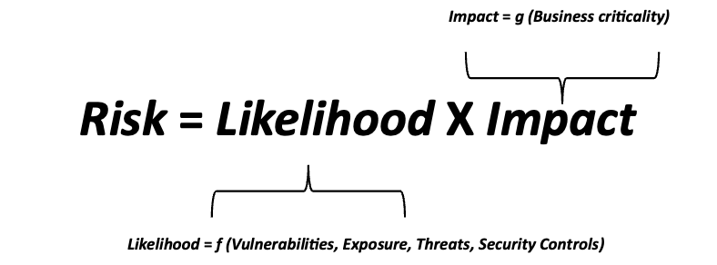


CYBER RISK QUANTIFICATION
You can learn more about how to rigorously estimate your cyber risk in money units by analyzing data from your various cybersecurity, IT and business tools.
Download eBook
22

Slide 24

AUTOMATED CYBER RISK QUANTIFICATION USING BALBIX PLATFORM
Traditional CRQ methods typically use a simplistic, tops-down, aggregate risk calculation leveraging subjective inputs – resulting in lack of confidence, trust, and usefulness of the analysis across stakeholders. Quantifying cyber risk can also take weeks of manual effort to complete, making it impossible to make real-time business decisions and quickly account for new threats.
Balbix helps customers quantify their cyber risk with a continuously automated, data-driven approach enabling clear communication, defensible analysis, and specific actions to dramatically lower cyber risk.
Download eBook
22

Slide 25
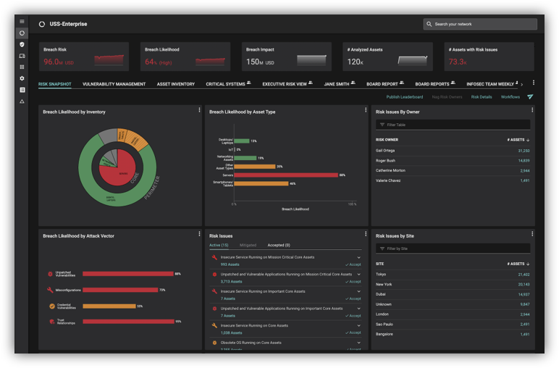

LEARN MORE ABOUT BALBIX
In 30 minutes, we will show how Balbix can help you automate your cybersecurity posture.
With Balbix, you will use AI, automation, and gamification to discover, prioritize, and mitigate your riskiest vulnerabilities across all assets, applications, and software at high velocity.
You will also be able to quantify your cyber risk in $-terms, traceable to operational metrics and asset attributes driving this risk. Balbix provides practical actions you can take to mitigate this risk.
A single, comprehensive view of cybersecurity posture
22

